Slide 1

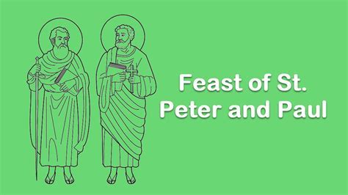
Celebration of the Word
https://www.bing.com/videos/riverview/relatedvideo?q=follow+me+hymn&mid=1F880FD47411C7CD5DBD1F880FD47411C7CD5DBD&FORM=VIRE

Slide 2
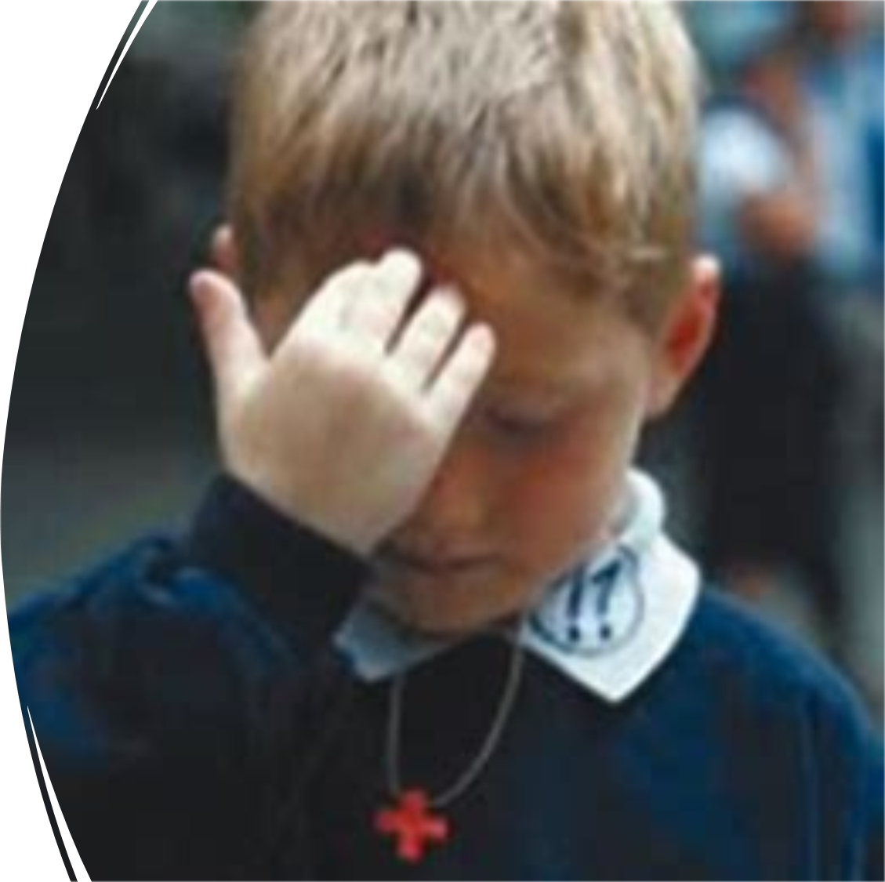
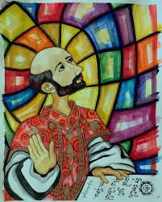
“Achieving our best by learning together and serving one another.”
Excellence
Service
Unity

Slide 3

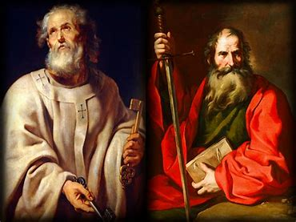
Today is the feast of St Peter and St Paul, two very special disciples of Jesus. In today’s gospel we hear how Jesus gave St Peter his name. Let’s listen and find out more.

Slide 4

Opening prayer
Living God, help us to follow you and to share our faith with others, through our actions and our words.
Amen.

Slide 5


The Lord be with you
And with your Spirit
A reading from the Gospel according to Matthew 16:13-19
Glory to you O Lord
The Gospel of the Lord
Praise to you Lord Jesus Christ
https://www.bing.com/videos/riverview/relatedvideo?q=st+peter+and+paul+video&mid=403662E1351BE7443F15403662E1351BE7443F15&FORM=VIRE

Slide 6


Jesus is very happy with Simon Peter and the faith that he has shown. He gives him a new name – Peter. A name which means rock. And Jesus says that he will build his Church on this rock. What do you think this means?
All buildings are built on rock. They have strong foundations so that they don’t fall down. https://www.bing.com/videos/riverview/relatedvideo?q=st+peter+and+paul+video&mid=403662E1351BE7443F15403662E1351BE7443F15&FORM=VIRE

Slide 7
So, how can we be like St Peter?
St Peter was just an ordinary man. But he gave up his job as a fisherman to follow Jesus and he was filled with faith.
We are just ordinary people too. But we can try to follow Jesus, to believe in him, and show our faith in the way that we treat others and in all that we do.

Slide 8
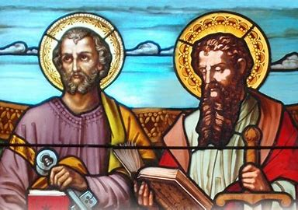
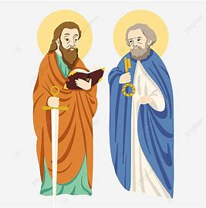
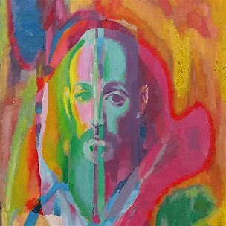


Slide 9


Slide 10

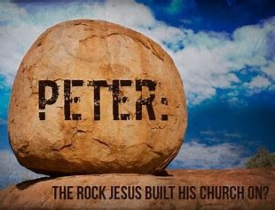
Go out and show your faith in Jesus in the way that you treat other people this week.
How can I be a ‘rock’ for others?
https://www.bing.com/videos/riverview/relatedvideo?q=follow+me+hymn&mid=1F880FD47411C7CD5DBD1F880FD47411C7CD5DBD&FORM=VIRE

