Slide 1
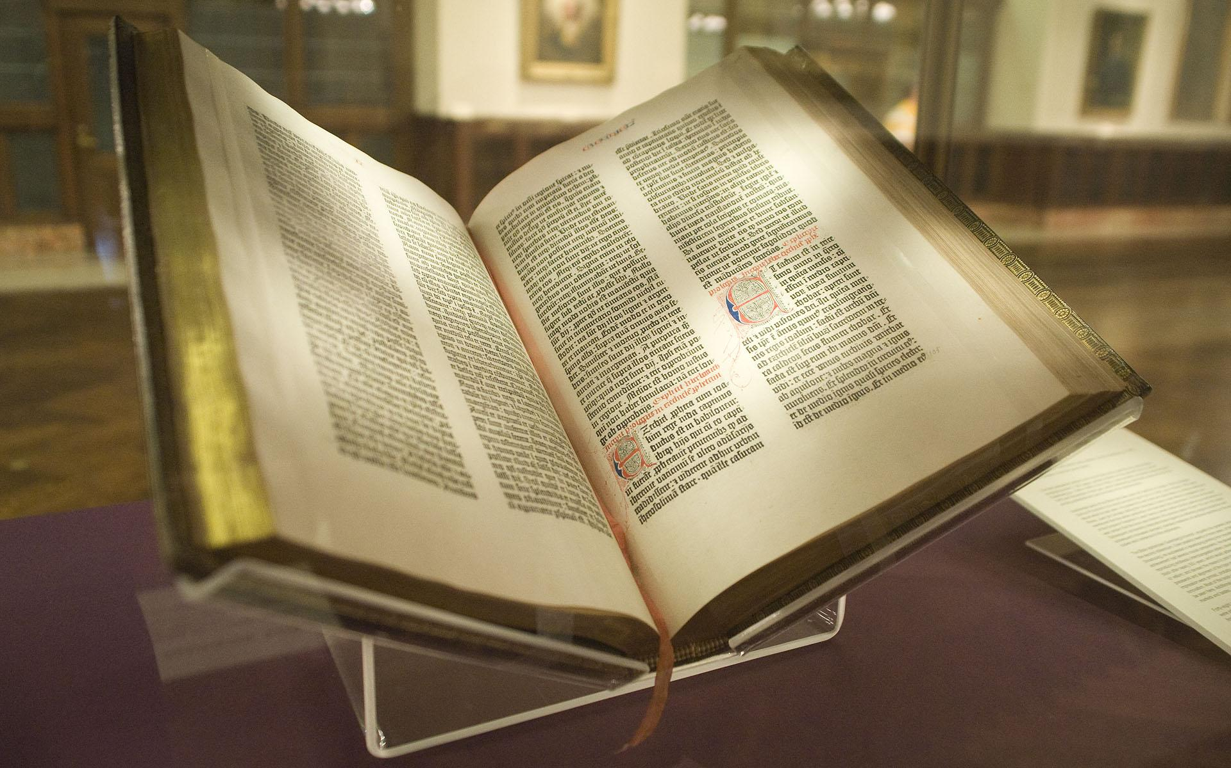
https://www.bing.com/videos/riverview/relatedvideo?q=Servant%20King%20Graham%20Kendrick&mid=64F3882BE6E9FBCB23AC64F3882BE6E9FBCB23AC&ajaxhist=0
Celebration of the Word

Slide 2
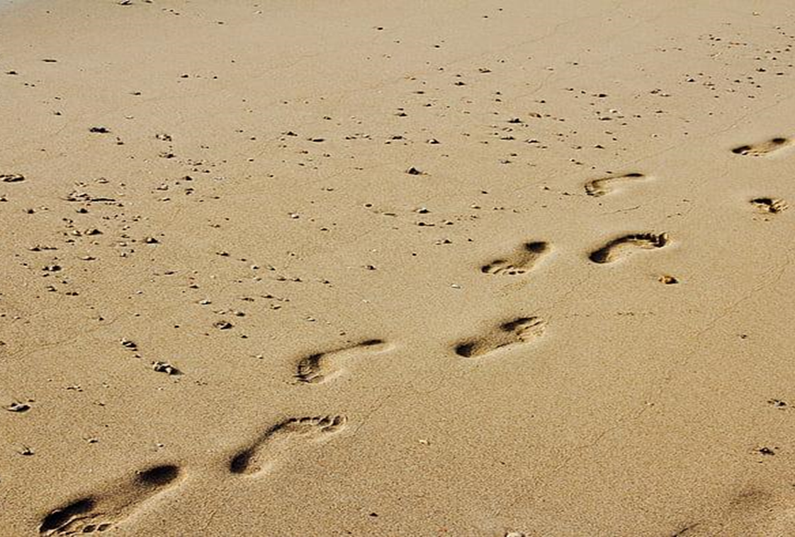
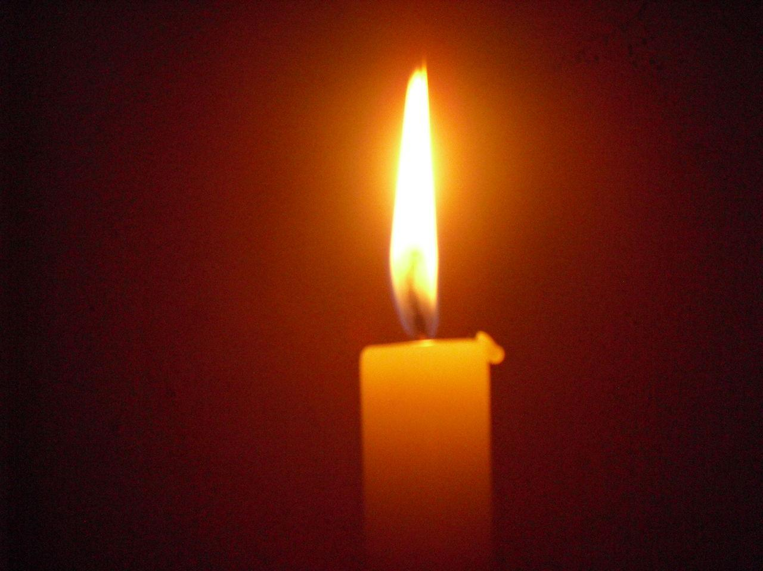
Gather

Slide 3

Welcome Prayer

Slide 4
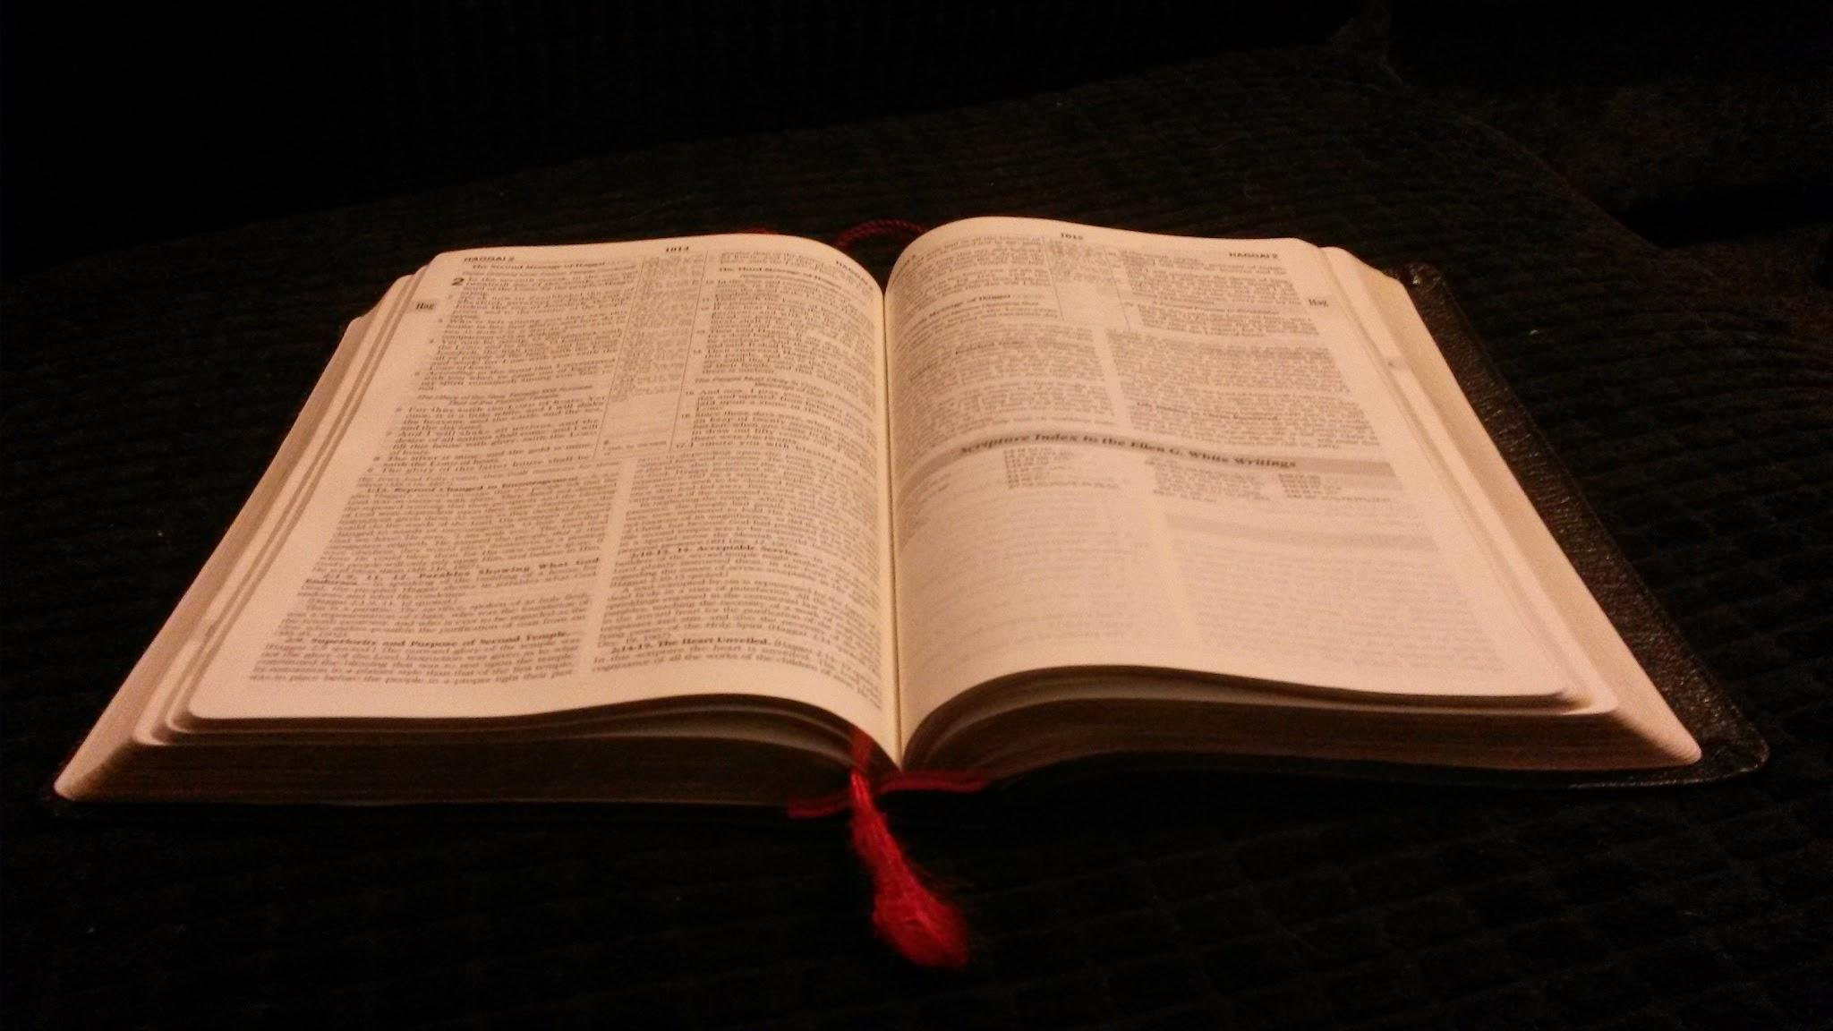
The Word
Mark 10:35-45

Slide 5

Reflect

Slide 6
Reflect
What do you think about what James and John asked?
Can you think of a time when someone was showing off about how important they were?

Slide 7
Reflect
Jesus said that the greatest disciple was not the one who went around showing off his power, or money, or things. But rather that the greatest disciple must be like a servant – humble and helping others in all that they do.

Slide 8

Bidding Prayers

Slide 9
Closing Prayer

Slide 10
Mission
Go out and do one helpful thing for someone else in the next week.

Slide 11


Slide 12


