Slide 1

Key Stage 1 Reading Workshop Supporting Your Child
Information and Guidance

Slide 2

Welcome!
We hope to provide you with as much information as we can, so you have a good understanding of how reading is taught in Year 1 and Year 2.

Slide 3
Aims for the session
To give parents and carers practical ideas of how to support their child’s reading
To give you an overview of how reading is taught at St Ignatius
To recommend reading lists and helpful resources
To stress the importance of working together to ensure all children can read at the highest level

Slide 4
Glossary
Prosody: reading with expression – with the appropriate rhythm, tone, pitch, pauses, and stresses for the text.
Inference: Writers often tell you more than they say directly. They give you hints or clues that help you "read between the lines." Using these clues to give you a deeper understanding of your reading is called inferring.
Fluency: Fluency is the ability to read a text accurately, quickly and with expression. Reading fluency is important because it provides a bridge between word recognition and comprehension.
Genre: The type or kind of book it is. In fiction texts you might find genres such as fairy stories, science fiction, adventure stories and mysteries. Non-fiction examples include recipe books, instruction manuals, history books and biographies.

Slide 5
What a St Ignatius reader looks like:
Can retrieve, compare and infer
Can discuss what they read
Reads with confidence
Reads for
Pleasure
Uses ambitious vocabulary
Can relate what they read to their own experiences/other texts/knowledge of the world
Can comprehend what they read

Slide 6
How we teach reading at school
Phonics & Spelling
Guided Reading (including individual and paired reading)
Shared Reading

Slide 7


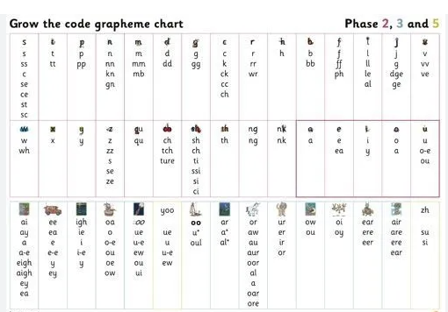
In Reception and Year 1, we follow Little Wandle phonics programme.
We focus on decoding, prosody and comprehension.

Slide 8
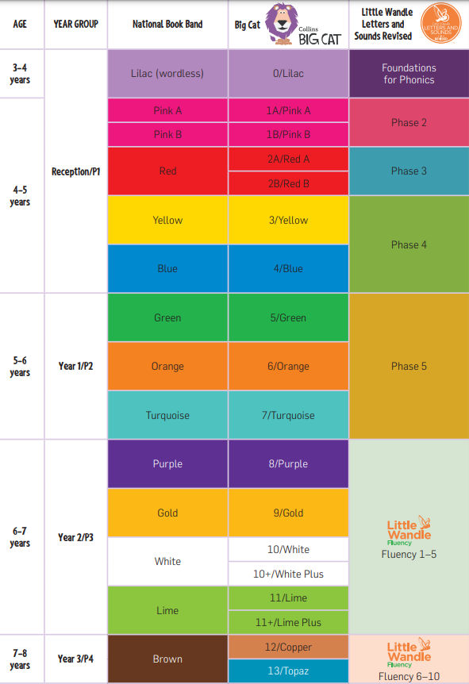

When children reach year 2 they will continue to read books from reading schemes including the Collins Big Cat series. This follows on from Little Wandle. These books are organized into levels. Some children will progress faster and some will progress more slowly as the books get more challenging. The most important thing is that they read with an adult every day at home. Please remember to record their daily reading in their Reading Diary.

Slide 9
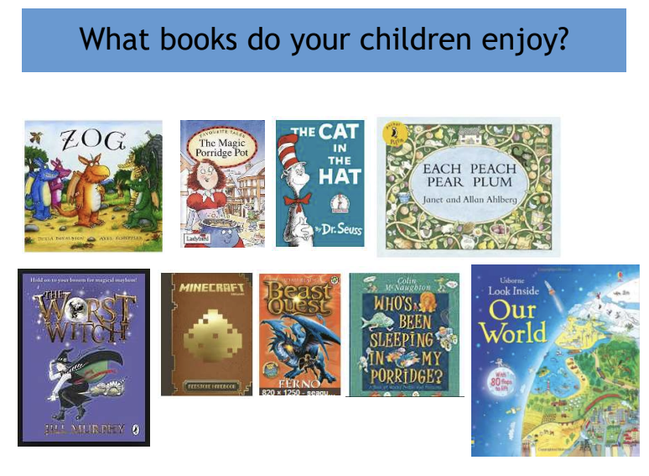

Slide 10

How can I support my child at home?
How to support reading…
Read your child’s reading book every day.
Regularly read a range of texts to your child, e.g:
  Weekly library books
  Homework comprehension texts
  Books from home
  Local Library Service

Slide 11
How do we teach and support Reading
Children are heard read regularly by their teachers.
Those that need extra support are heard read more often.
Taught Guided Reading three times a week.
Comprehension Home Learning.
NFER Assessment test at the end of every term, which are sent home so that the results can be shared.
Regular fluency checks
Each class has a class text read to them – deliberately challenging.
Parents and Carers are the key to unlocking reading for pleasure! Please read and complete Reading Diaries at least 5 time a week, every day if possible.

Slide 12
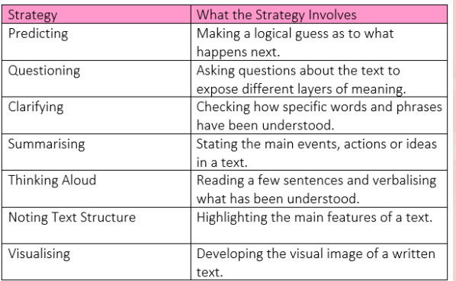
What happens in a Guided Reading lesson?
There’s a focus on prior knowledge and vocabulary
Echo reading and paired reading
Skills: vocabulary, retrieval and inference are some examples
Each class has a class reader that their writing may also be based on
Other skills

Slide 13
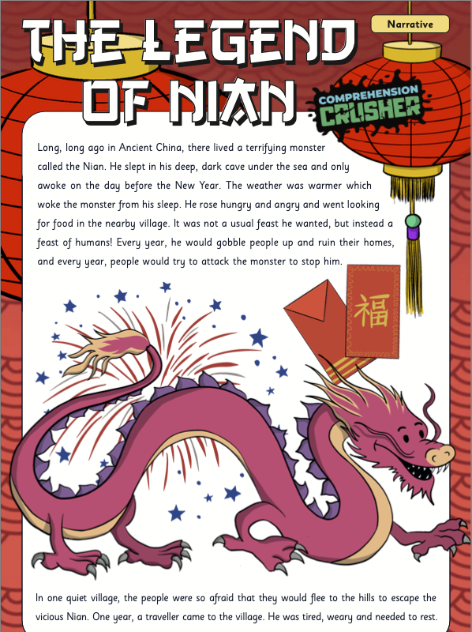
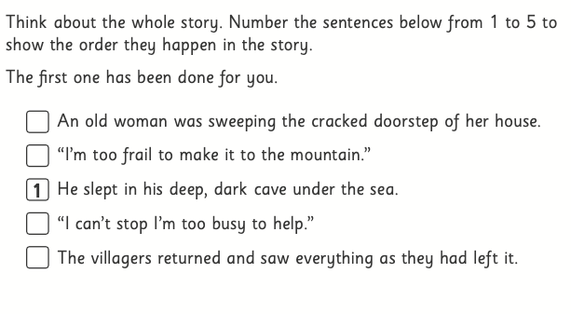
This text focuses on developing sequencing, vocabulary & meaning and inference skills.

Slide 14
When reading with your child, ask them questions such as:
Which word on this page means the same as...?
Can you find a noun/adjective/verb that tells/shows you that...?
Who is/are the main character(s)?
When/where is this story set? How do you know?
How do you think the character felt when…..? Why?
Do any of the characters remind you of someone that you know? Why is that?
Where do you think.... will go next?
What do you think... will say/do next?

Slide 15
Discussion prompts for more challenging texts.
Prior to reading
• Have you read any other books by the author? Tell us about them.
• Do the cover and the title give you any clues about the type of
story this might be?
Good questions to get discussion moving
• What made you want to keep reading this book?
• Was there anything that put you off reading this book?
• Did this book remind you of any other books you have read or
films that you have seen?
• Did it remind you of something that has happened to you or
someone else?
• Was there anything that puzzled you about this book?
• Did anything surprise you in this book?

Slide 16
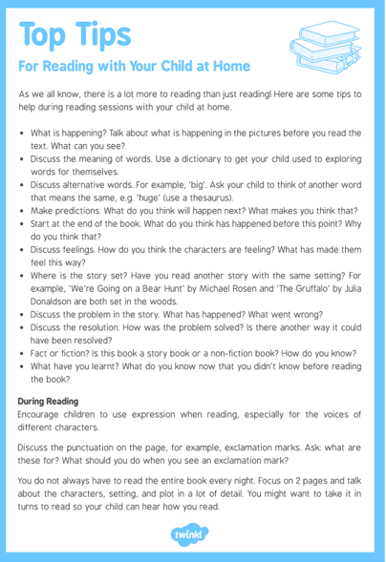

How can you help?
Choosing the right book is really important.
• School library – it is stocked with carefully chosen texts.
• Visit your local library.
• Vary the genres – try something new!
• Try to avoid repeating popular authors again and again
• Explore new language and ask your children to summarise what they
have read.
• Use the question prompts available in your child’s Reading Diary
• Year 2 children can start writing their own comments

Slide 17

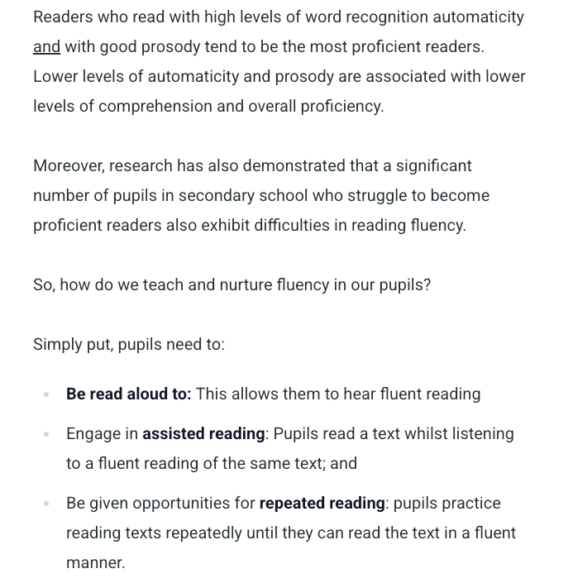
Why is Fluency important?

Slide 18
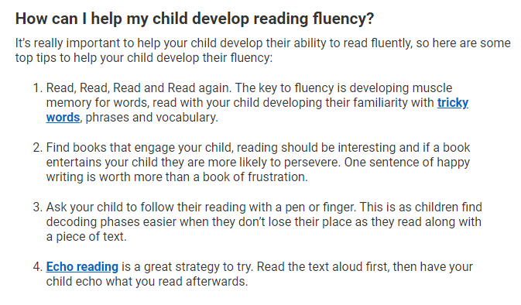
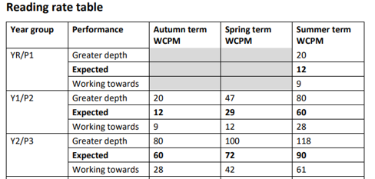
Fluency

Slide 19
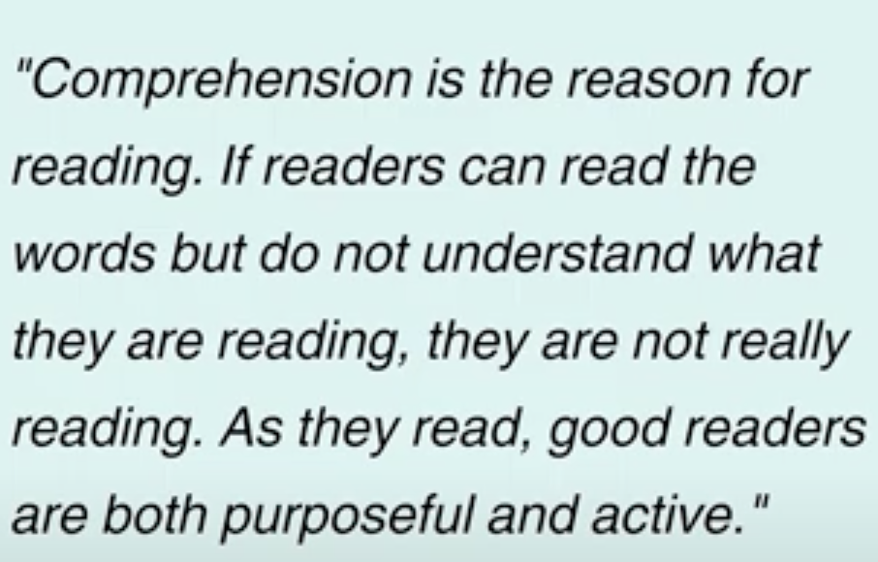
Put Reading First Guide (2006)

Slide 20
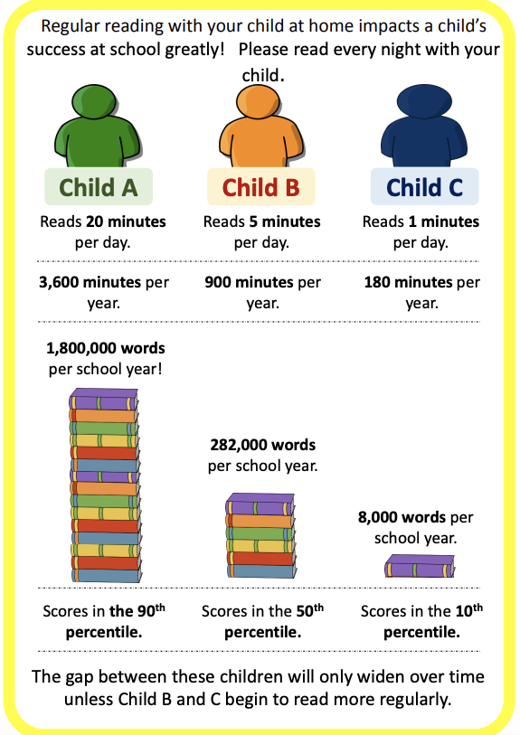

Slide 21

Useful Websites for book recommendations and eBooks...
https://home.oxfordowl.co.uk/reading/
https://www.thereaderteacher.com/
https://schoolreadinglist.co.uk/reading-lists-for-ks1-school-pupils/year-2/
https://www.booksfortopics.com/booklists/books-by-age-and-year-group/ks1/
https://www.booktrust.org.uk/books-and-reading/our-recommendations/
Encourage a love of reading:
Use audio books – listen to stories when you’re driving
Talk to your child – make sure they answer in full sentences – this will really help with writing
Limit screen time
Visit bookshops
Explore websites together such as Newsround, National Geographic Kids, First News, Phoenix Comics
Encourage children to read everywhere e.g. bus advertisements, billboards, package labels, ingredients
Read a range of genres and authors
Read higher level texts aloud
Get excited about authors and genres that you enjoy

Slide 22
Thank you for your time
If you have any further questions, please email your class teacher.

Slide 23




Dates for your diary
We are very excited to welcome the poet Christian Foley on Friday 7th March. Christian is a Spoken Word Poet, Musician and Educator. Exciting poetry workshops await….what will the children create?

