Slide 1


KS2 English
St Ignatius Catholic Primary School
Notes:
Welcome to St Ignatius. Thank you for coming
My name is Mrs W and this is my colleague Mr Penson and we are going to talk to you about how we teach English at St Ignatius and how you can support your child at home.

Slide 2
What we will cover today
  Oracy
  The Place Value of Punctuation and Grammar
  Spelling
  Handwriting
  Writing Journey
  Reading
  Assessment

Slide 3
Oracy
It's about having the vocabulary to say what you want to say and the ability to structure your thoughts so that they make sense to others.

Slide 4
Oracy - helping at home
  actively engaging in conversation with your child.
  ask your child to explain their reasons and teach them that it is good to disagree and to change your mind.
  Initiate some discussions and debates – dinner time is a great time to do this as a family.
  about books and life experiences.

Slide 5
Oracy - helping at home
  Discuss new words and support them to broaden their vocabulary.
  Would you rather ...? (live in the countryside or the city, live in Ancient Greece or Ancient Egypt)
  Which book character would you invite to your birthday party? Why?
  Take it in turns to say a different word for a common word. For example: looked could also be peered, noticed, spotted.
  Play role play games that involve speaking

Slide 6
The Place Value of Punctuation and Grammar
  Taught at the start of every year
  Recaps on syntax
  Focus on grammar for sentence construction
  Comes with a script
  Has shown improvement in our writing so far
  Worksheets for homework

Slide 7
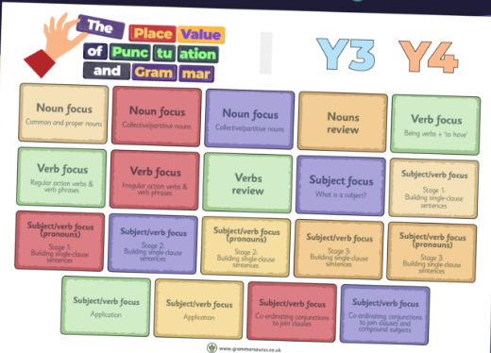

The Place Value of Punctuation and Grammar
Overviews

Slide 8
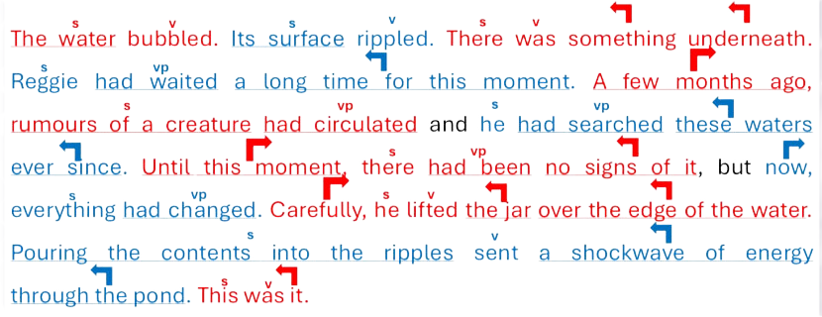
A Year 4 Example

Slide 9
Helping at home - Sentence Construction
s
v
s
vp
the boy stretched he was tired
.
.
  Find verbs then the subject.
  Say ‘who or what is doing the ‘verb’?
  I put my full stop....why?
  “Because it’s a full independent clause with a subject and verb so I put a full stop and go back and add a capital letter.”
  Weekly homework sheets will be coming home from Years 3 - 5 to recap

Slide 10
Spelling
  Taught three times a week
  Children are assessed on the Y2 curriculum before moving onto the year group spellings
  After phonics, spelling is focused on a morphology approach focusing more on the meanings of words
  No weekly lists
  Spellings will be used in the writing journey

Slide 11
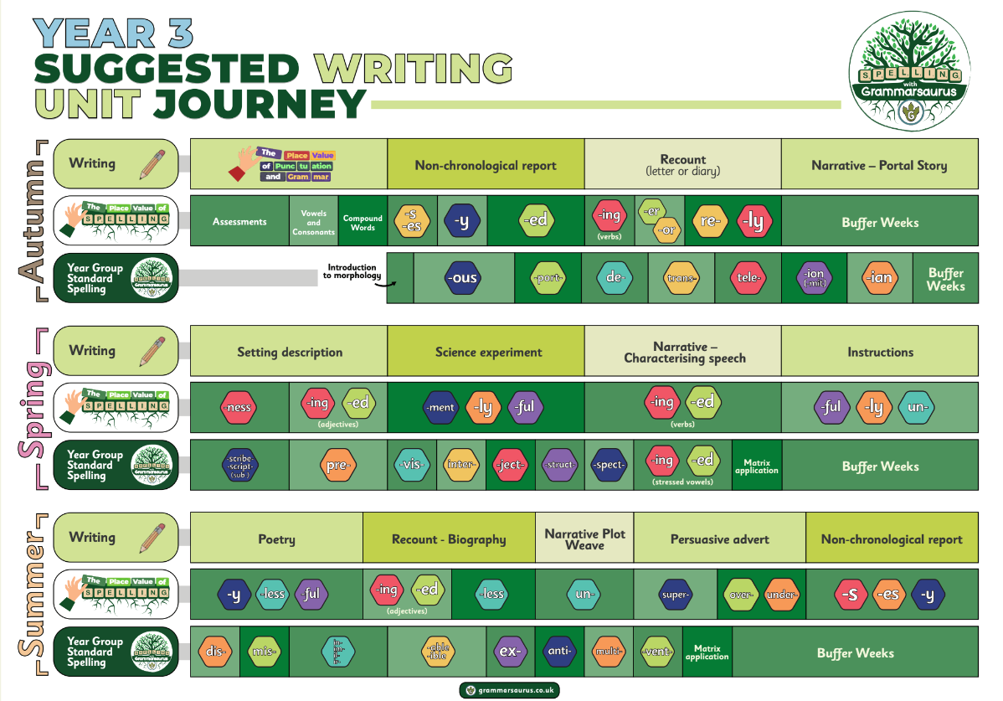

Slide 12
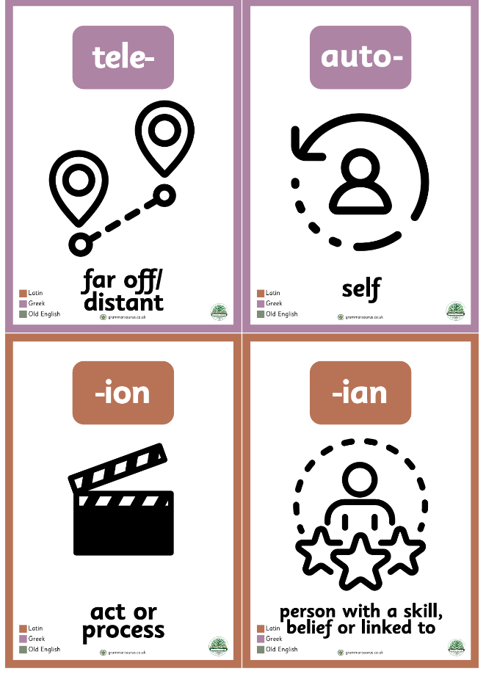

Slide 13
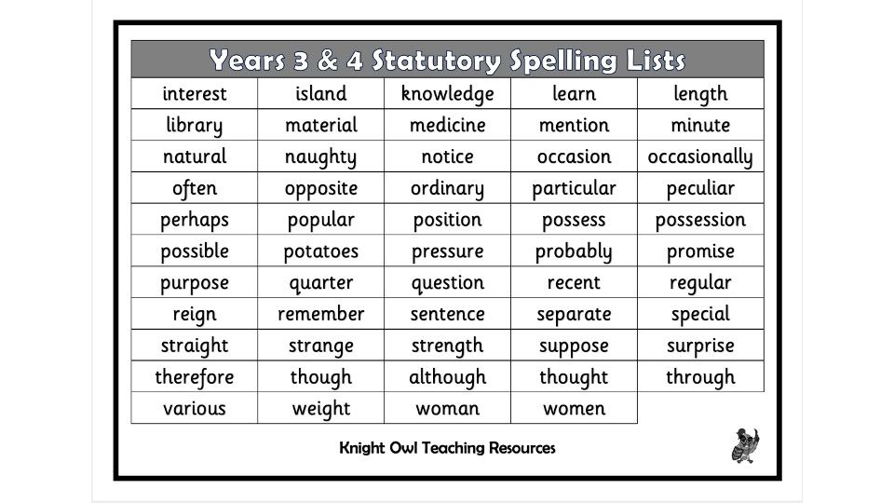
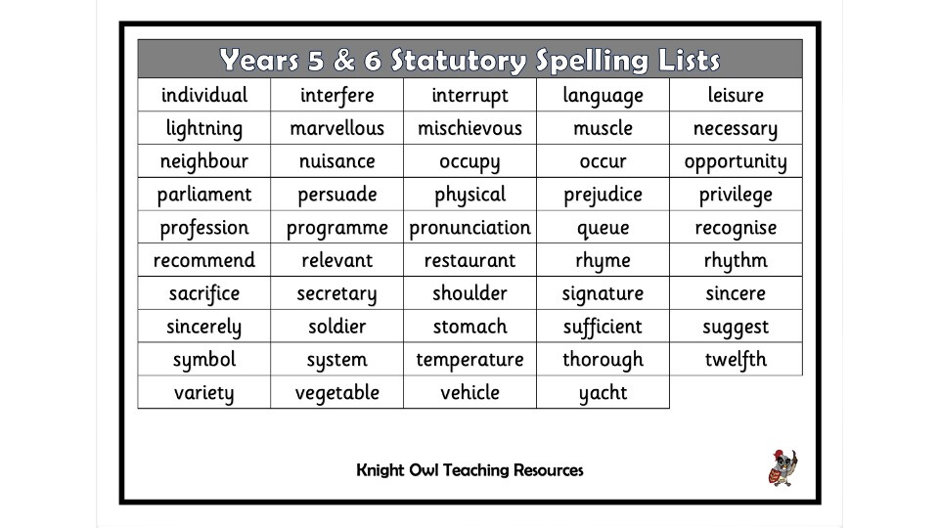
Spelling - helping at home

Slide 14
Spelling - helping at home
  Weekly spelling homework sheets
  Spelling games on BBC Games
  Asking children what words mean that have the prefix or suffixes they have focused on.
  Learning the 3/4 and 5/6 spelling words

Slide 15

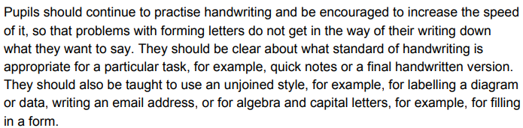
Why do we still teach handwriting in KS2?
By the end of Y4
By the end of Y6

Slide 16
Handwriting
  Taught three times a week
  English books
  Focus on letter formation
  Key terms are legibility and fluency
  Handwriting pens are used from Y4 onwards
  High expectations

Slide 17
Handwriting - helping at home
  Encourage children to write using a variety of tools
  Have high expectations for homework
  Question why they haven’t used joined up handwriting in any writing that they do.

Slide 18
Writing Journey
  Takes place after completion of PVPG
  Based on either a quality text or Science experiment
  Builds on grammar skills for the year group
  Each unit takes about three weeks
  Work is edited and published

Slide 19
Writing Journey

Slide 20
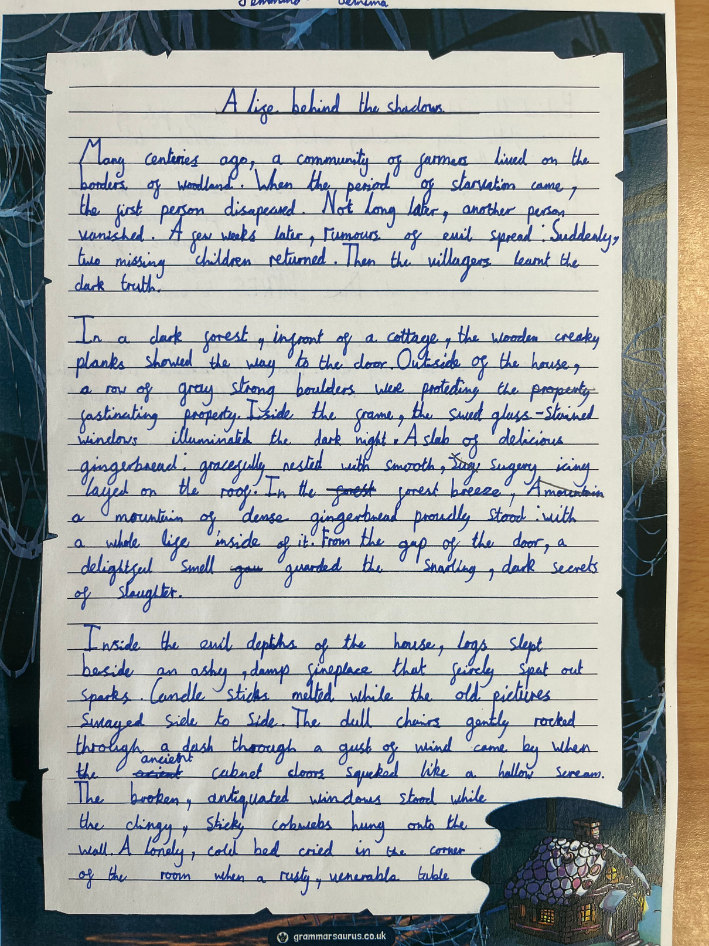
Writing Journey

Slide 21
Writing - helping at home
  The best practice is writing as much as possible!
  Encourage as many opportunities to write - postcards, shopping lists, reminders
  Keeping a diary/journal of important days
  Have a special pen that can only be used now and then.
  Going in for writing competitions

Slide 22
Reading
  Reading lessons take place three times a week.
  We focus on prior knowledge and vocabulary
  Echo read and timed read
  Focus on different reading skills - mainly vocabulary, retrieval and inference.
  Each class has a class reader that their writing may based on.

Slide 23
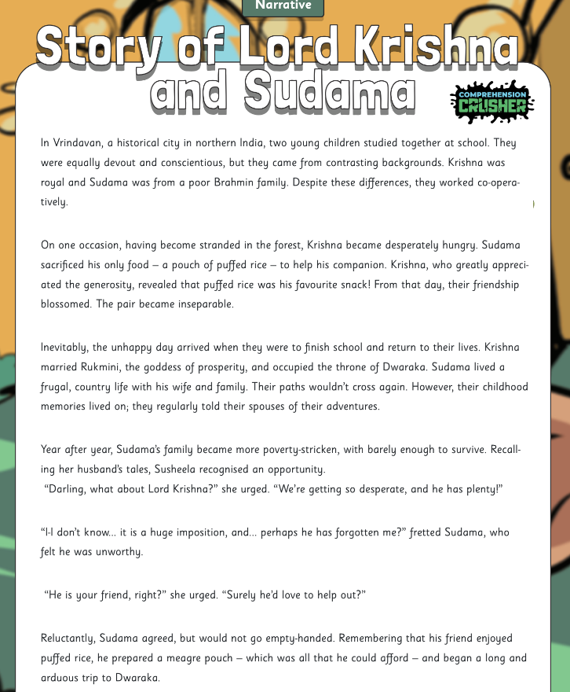
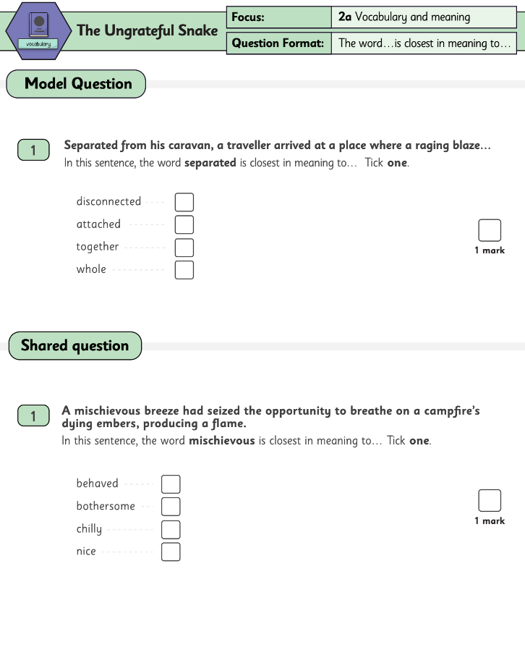
Reading Comprehension

Slide 24
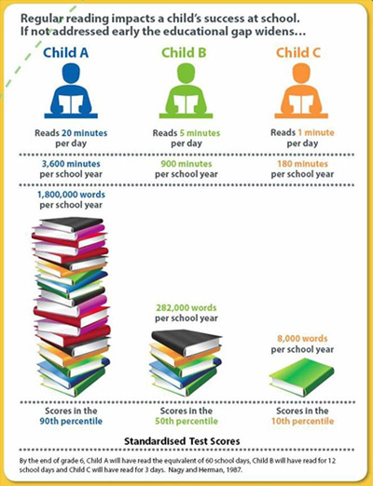
Reading at home
Reading really is the key to everything!

Slide 25
Where to find quality book lists
  Books4Topics - fantastic range of books linked to topics or ages
  Booktrust’s Bookfinder
  Schoolreadinglist.co.uk
  TheReaderTeacher

Slide 26
Encouraging Reading for Pleasure
  Library - free and for everyone!
  Libby app linked to your library card.
  Borrowbox
  Comics/magazines/child-friendly newspapers
  Audiobooks on streaming services like Spotify (can be used with Alexa)
  Kindle/tablet

Slide 27
Encouraging Reading for Pleasure
  Ringfence a time for your child to read
  Read what they are reading and chat about it
  Use reading time to earn minutes for other activities

Slide 28
Assessment
  Assessments take place three times a year
  English assessments will be in the form of Spelling, Grammar and Reading through formal testing.
  Writing will be teacher assessed with opportunities to compare with other schools.

Slide 29
Assessment
  There aren’t specific pass marks - children are banded
  Children will receive a scaled score
  100 is the average score for children working at age-related expectations
  Boosters
  You will receive the papers to help fill the gaps.

Slide 30
Thank you for coming
Any questions?

