Slide 1

Welcome to the EYFS & KS1 Maths Workshop

Slide 2
Session aims
To see what maths looks like in EYFS and KS1.
To see how is maths taught at St Ignatius.
To find out how children can be supported at home.

Slide 3
What does Maths look like in EYFS?
Learning through play.
Outdoor activities.
Counting, counting and more counting!
Pattern spotting
Number recognition and ordering to 10.
Learning numbers bond up to 10.
Shape recognition, 2D and 3D.
Addition and subtraction using single digit numbers.

Slide 4
What does Maths look like in Year 1?
Number bonds to 10 and within 10.
To double numbers to 10.
Recognise odd and even numbers.
Count forwards and backwards in multiples of 2, 5 and 10.
Compose numbers to 10 from 2 parts, and partition numbers to 10 into parts.
Recognise common 2D and 3D shapes presented in different orientations, and know that rectangles, triangles, cuboids and pyramids are not always similar to one another.
Count within 100, forwards and backwards, starting with any number.
Read, write and interpret equations containing +, - and = symbols.

Slide 5
What does Maths look like in Year 2?
Secure fluency in addition and subtraction facts within 10.
Practical learning using a variety of resources.
Recognise the place value of each digit in two-digit numbers.
Add and subtract within 100 by applying one-digit addition and subtraction facts. To add and subtract any 2 two-digit numbers.
Recognise the subtraction structure of ‘difference’ and answer questions such as “How many more…?”.
To describe the properties of 2D and 3D shapes and compare shapes by their properties

Slide 6




How is maths taught at St Ignatius
Our curriculum is based on the national curriculum
We follow White Rose Maths which breaks the national curriculum into small steps.
We use other materials to support the delivery of the curriculum. These include: Third Space Learning, Grammarsaurus and NCETM.

Slide 7
How is maths taught at St Ignatius
White Rose Maths
Breaks learning into small, sequential steps to build understanding gradually.
Focuses on mastery, where children fully grasp one concept before moving on to the next.
Includes activities for problem-solving, reasoning, and exploring maths in a variety of contexts.
Grammarsaurus Resources
Provides engaging materials to supplement lessons, including interactive games, challenges, and visual aids.
Supports children with different learning styles through creative approaches to maths.

Slide 8
How is maths taught at St Ignatius
Mastering Number
The Mastering Number Programme lays a strong foundation in number knowledge by:
Subitising:
Helping children instantly recognise small quantities (e.g., seeing that 5 dots on a dice is 5 without counting).
Builds confidence and reduces reliance on counting.
Key Number Knowledge:
Deepens understanding of number bonds (e.g., pairs that make 10), place value, and relationships between numbers.
Develops fluency with numbers so children can confidently move on to calculations and problem-solving.
Daily Practice:
Short, focused sessions to embed number sense and improve fluency over time.
Uses visual tools like ten frames, number lines, and counters to support understanding.

Slide 9
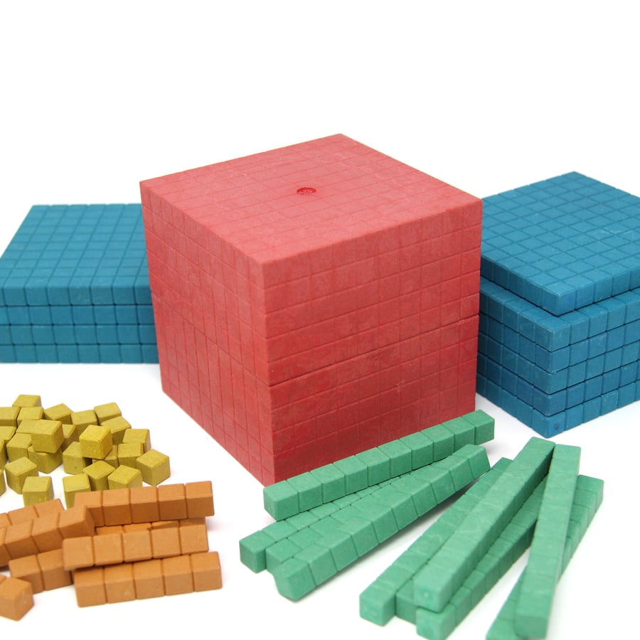
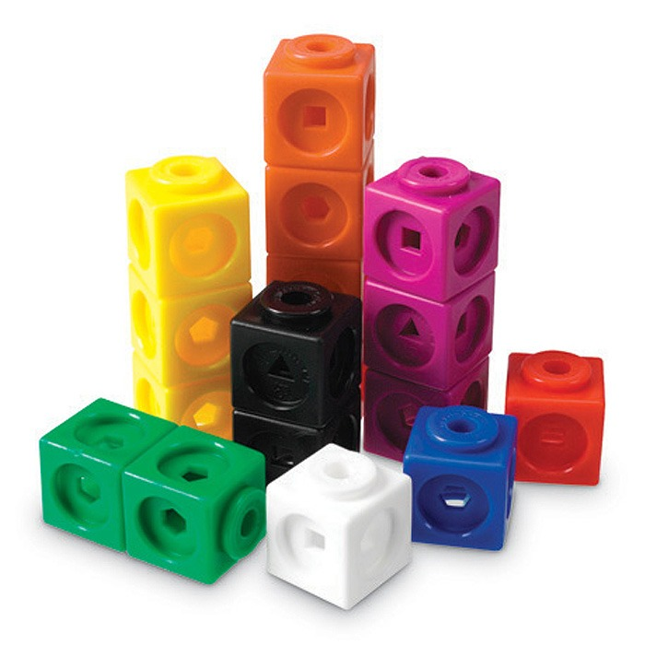
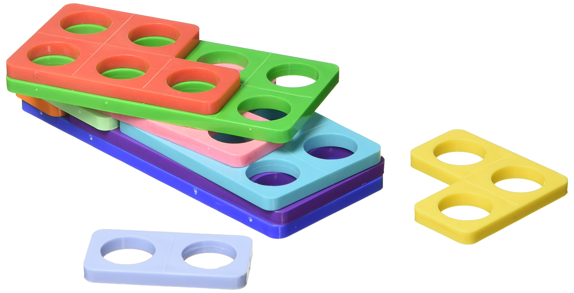
Manipulatives and Resources
Resources can be powerful tools to support sense making, mathematical thinking and reasoning skills.
They help our children to be able to practically engage with new learning and to support their ability to visualise new concepts and knowledge.
We apply a CPA approach to Maths learning which embeds the importance of using physical resources to support learning opportunities.

Slide 10
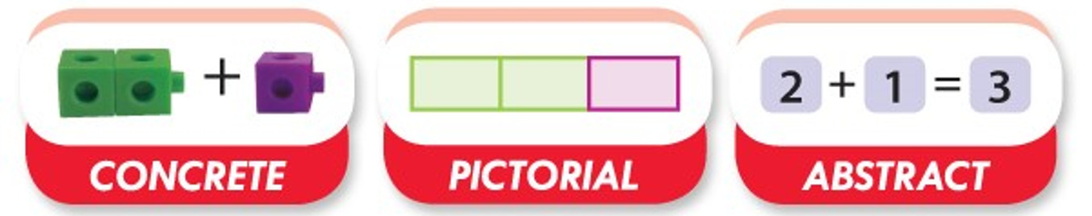
Manipulatives and Resources

Slide 11
Manipulatives and Resources
C is for Concrete.
New concepts are introduced through the use of physical objects or practical equipment. These can be physically handled, enabling children to explore different mathematical ideas. These resources are sometimes referred to as maths manipulatives and can include everyday household items such as straws or dice, as well as specific mathematical tools like Dienes blocks or Numicon.
P is for Pictorial.
Once children are confident with a concept using concrete resources, they progress to pictorial representations. This means they no longer manipulate physical objects but still benefit from the visual support that these representations provide.
A is for Abstract.
When children have a secure understanding of the concept through concrete resources and visual images, they move on to the abstract stage. Here, children use symbols, such as numbers and mathematical notations, to solve problems. To access this stage effectively, children need continued access to the previous two stages alongside it.

Slide 12
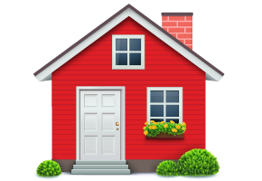
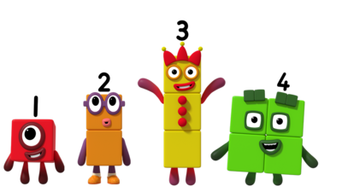
Manipulatives and Resources
Resources you can use at home.

Slide 13
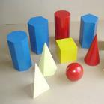

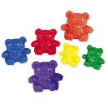
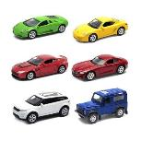

Manipulatives and Resources
Alternative to maths resources.
3D shapes or you could use… Shopping
Counting Bears or you could use… Anything you have a lot of

Slide 14
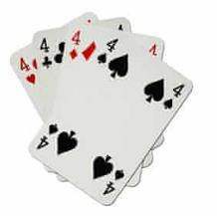
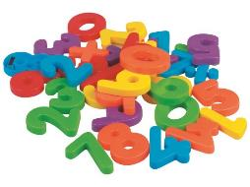
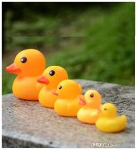
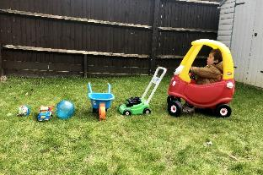
Manipulatives and Resources
You can use anything you have around the house.
Magnetic numbers for
number recognition
Cards for number
recognition and counting
Toys to put in size order

Slide 15
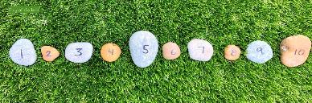
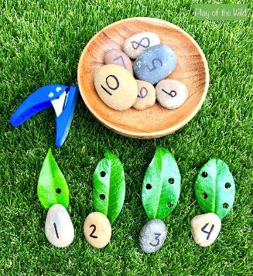
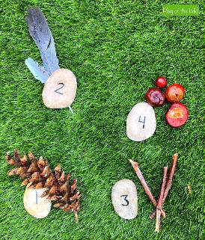
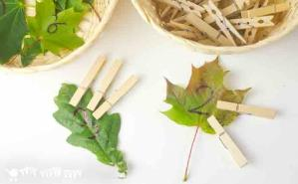
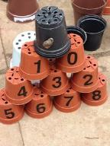
Manipulatives and Resources
Don’t forget outside.

Slide 16
Reasoning and Problem Solving
Reasoning
The action of thinking about something in a logical, sensible way.

Slide 17





Reasoning and Problem Solving
How many different ways can the objects be grouped?

Slide 18
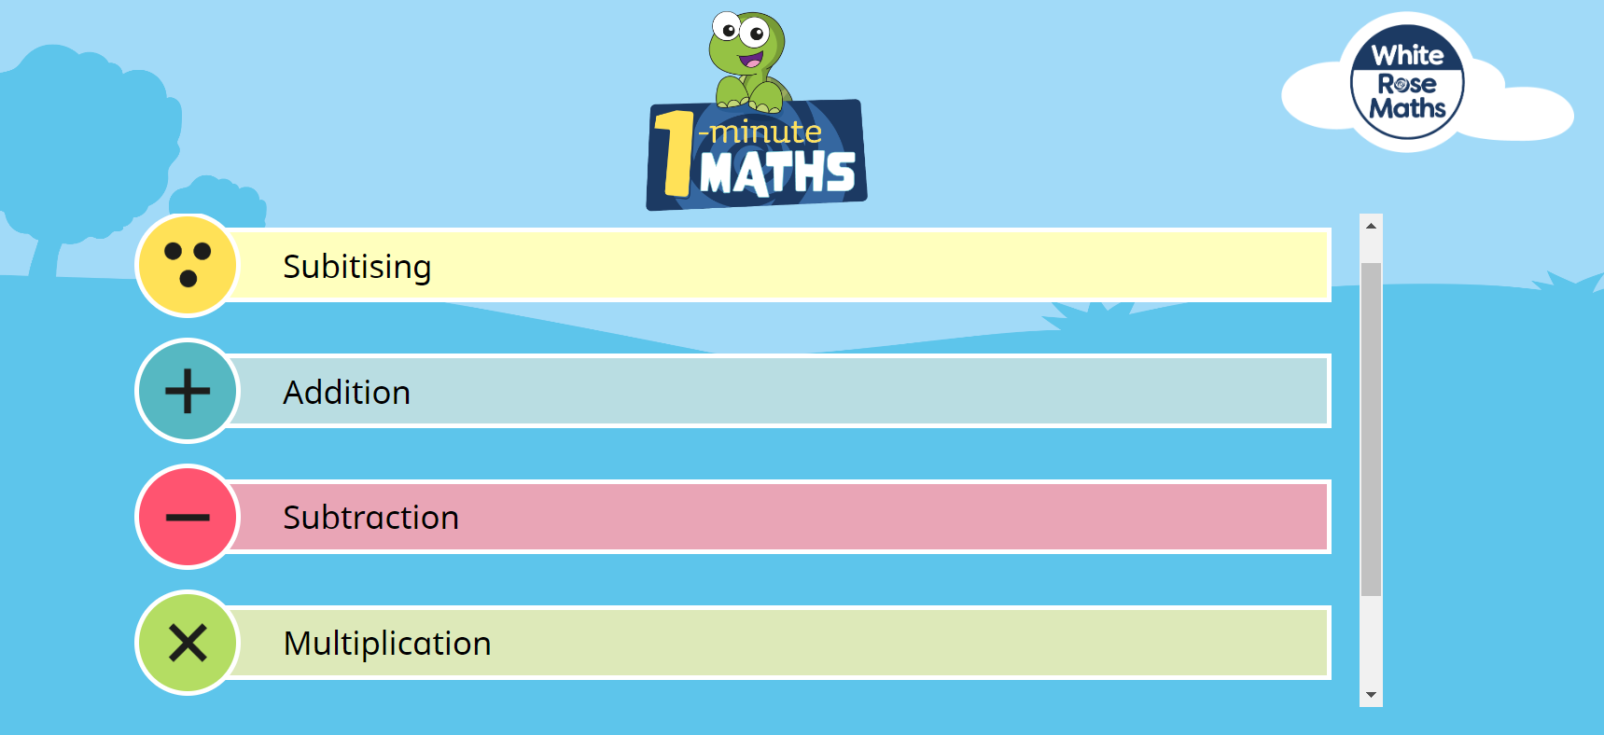

How can you help your child at home?
One way to support your children is by using 1 Minute Maths

Slide 19
How can you help your child at home?
One way to support your children is by using 1 Minute Maths
We recommend this app for EYFS and Key Stage One children to help them develop their mental arithmetic skills. White Rose Maths is used by many schools to support the planning and activities in class, and now they have developed 1 Minute Maths for children to use at home.
The app can be downloaded through the Apple Store, Google Play or Amazon Kindle app stores and is currently free of charge.
Once in the app, children can select from subitising (recognising amounts without needing to count them), adding, subtracting and multiplying.
Within each section, children can select practice activities that they have been learning in class and use the quick-fire questions to help improve their recall of key number facts.

Slide 20
How can you help your child at home?
Encouraging a Positive Approach to Maths
Take Away Their Fear:
Help your child feel confident and at ease with maths by creating a supportive environment.
Reassure and Praise:
Offer encouragement and praise whenever possible to build a positive mindset.
Play with Numbers and Shapes:
Incorporate games that involve numbers and shapes to make learning fun and interactive.
Embrace Mistakes as Learning Opportunities:
Encourage your child to see mistakes as valuable opportunities to learn. Use them as discussion points to explore new ideas and approaches.

Slide 21
How can you help your child at home?
Count: Steps up the stairs, coins going into a money box, or other everyday activities.
Encourage subitising: Ask children to say how many objects there are (for groups of 5 or fewer) without counting.
Play dice or domino games: Encourage children to quickly recognize the number of spots without counting each one.
Involve them in practical tasks: For example, ask children to set the table with the correct number of knives, forks, and plates for everyone.
Spot numbers in the environment: Look for numbers on phones, microwaves, clocks, registration plates, and doors.

Slide 22
How can you help your child at home?
Watch educational shows:
Numberblocks (CBeebies): Written by maths specialists to model mathematical concepts and represent numbers brilliantly.
Numberjacks: A great show for problem-solving activities.
Create a number hunt: Hide numbers around the house or garden and challenge children to find them.
Play outdoor maths games: Hopscotch, skittles, or other active games can be great for exploring maths concepts. Even better, let children invent their own games and decide how to score points.
Talk about “more” and “less”: Use everyday opportunities to compare amounts and draw attention to these concepts.

Slide 23
Any Questions?
Thank you for attending the EYFS and KS1 maths workshop.

