Slide 1

Welcome to the KS2 Maths Workshop

Slide 2
Session aims
To see what maths looks like in KS2.
To see how maths is taught at St Ignatius.
To find out how children can be supported at home.
The importance of Times Tables.

Slide 3
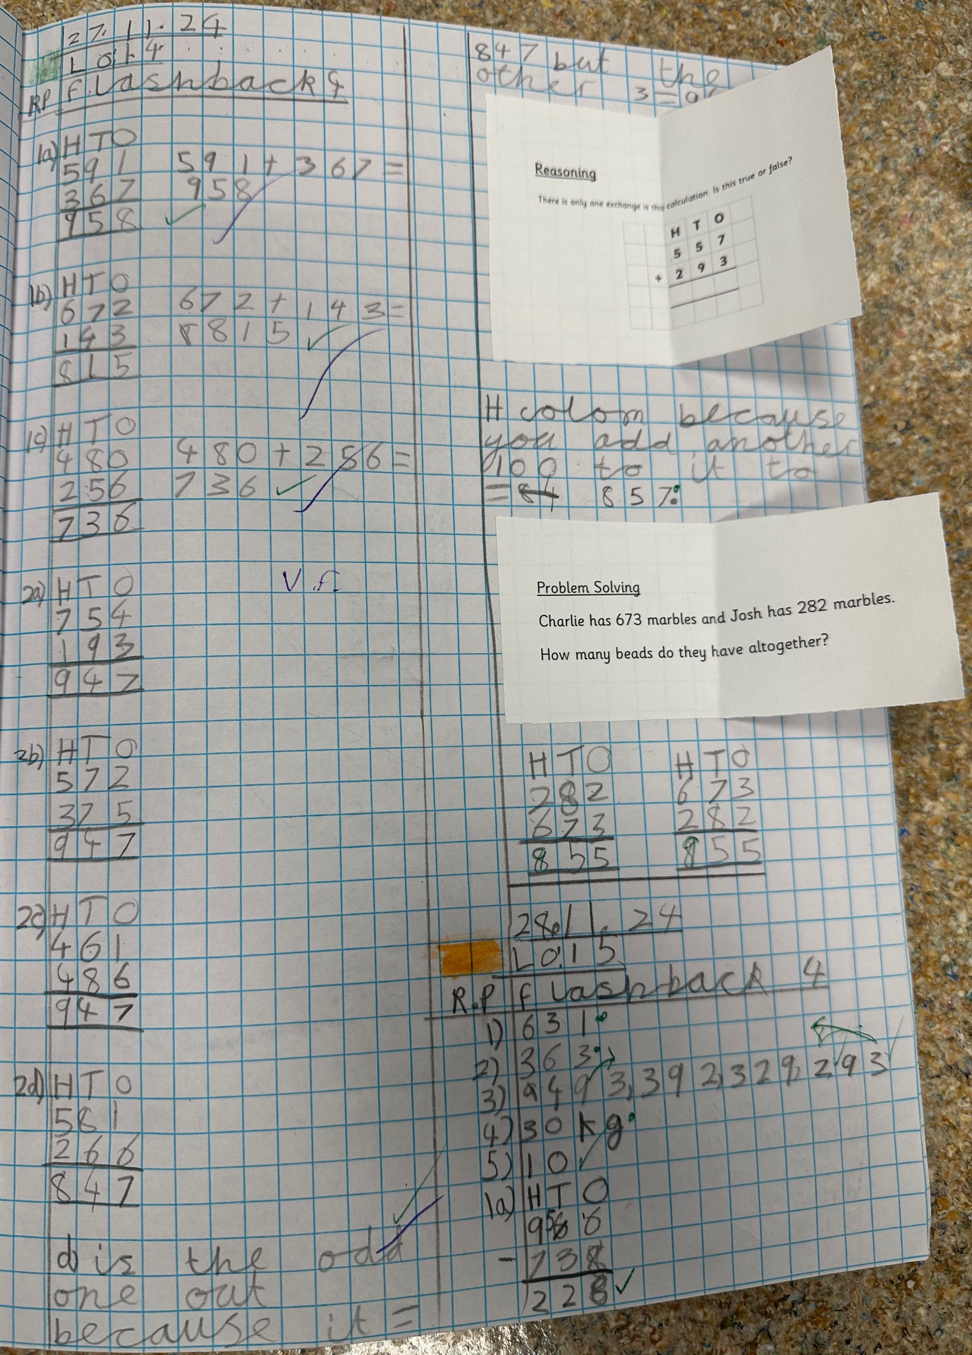
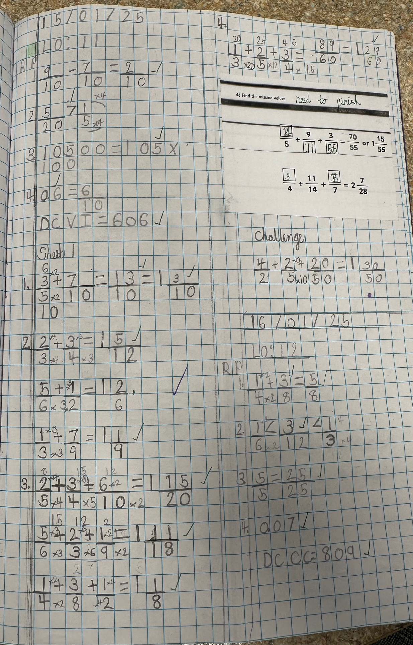
What does Maths look like in Year 3?
Consistently use the correct number formation (0-9).
To choose strategies to help me answer questions such as partitioning, number lines, counting on, counting back, bar models and eventually formal methods such as the column method.
To recognise the place value of each digit in a three-digit number (hundreds, tens and ones).
To read and write numbers up to 1,000
To identify angles greater than or less than a right angle
To add and subtract mentally and scaling these by 10 e.g. 6 + 3 = 9, 60 + 30 = 90.
To recall my 2, 5, 10s, 3, 4 and 8 times tables and related division facts.
To understand the inverse relationship between add and subtract
To solve number and practical problems, including reasoning using my number knowledge.

Slide 4
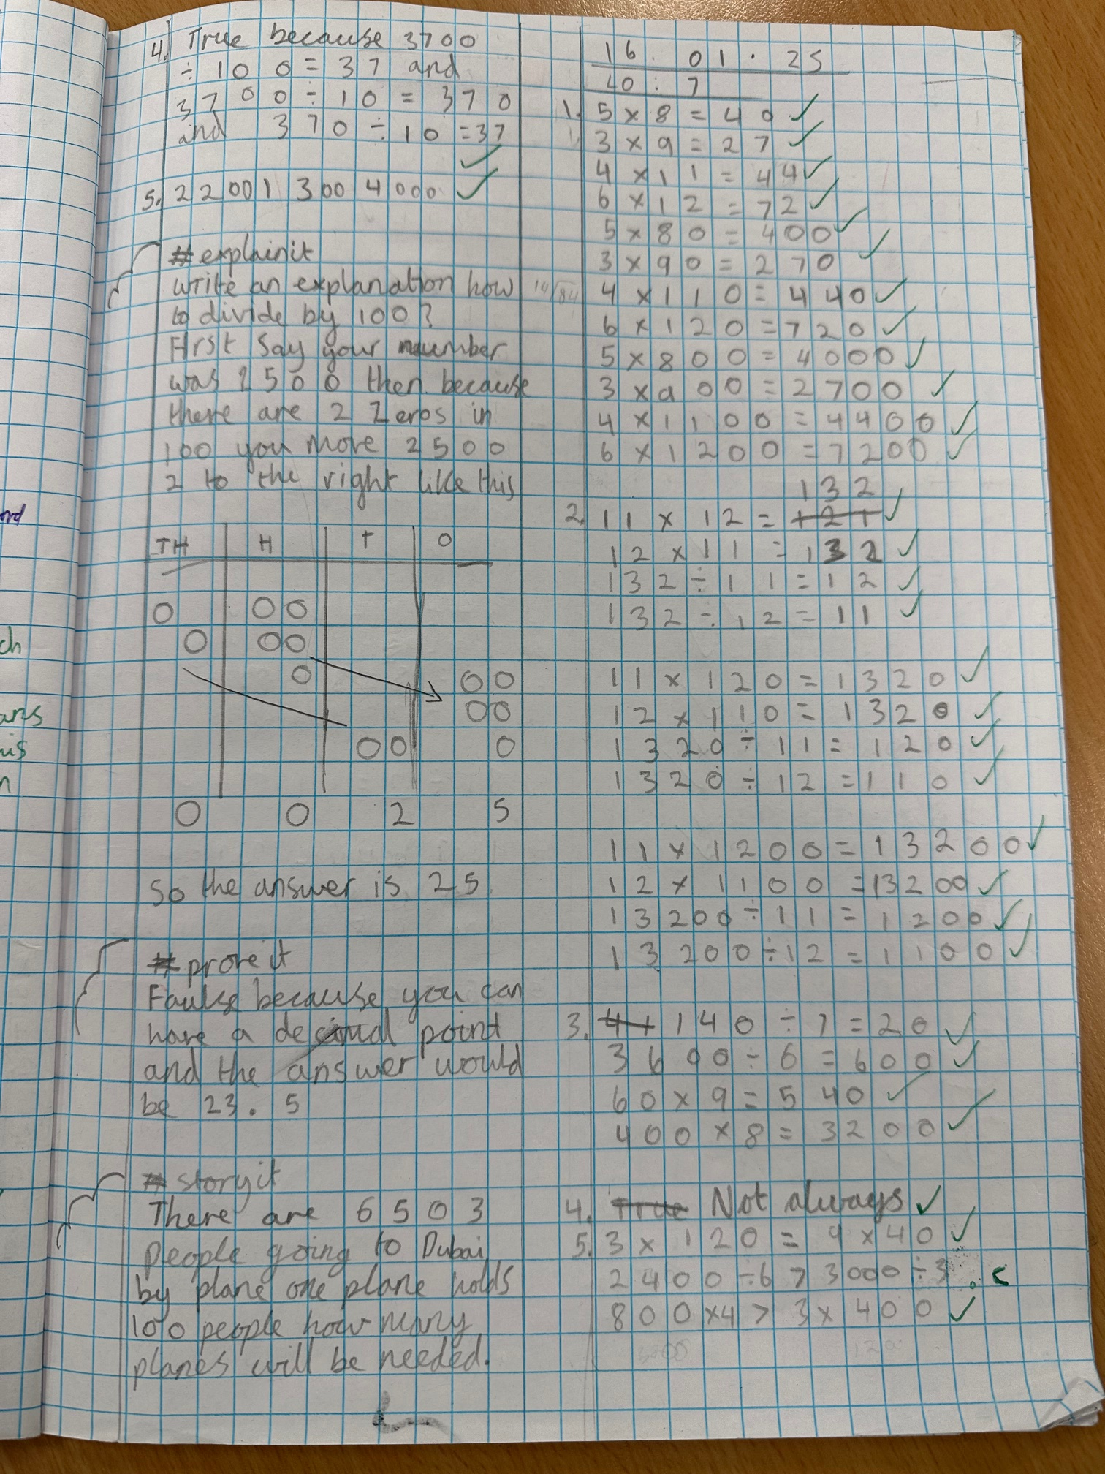
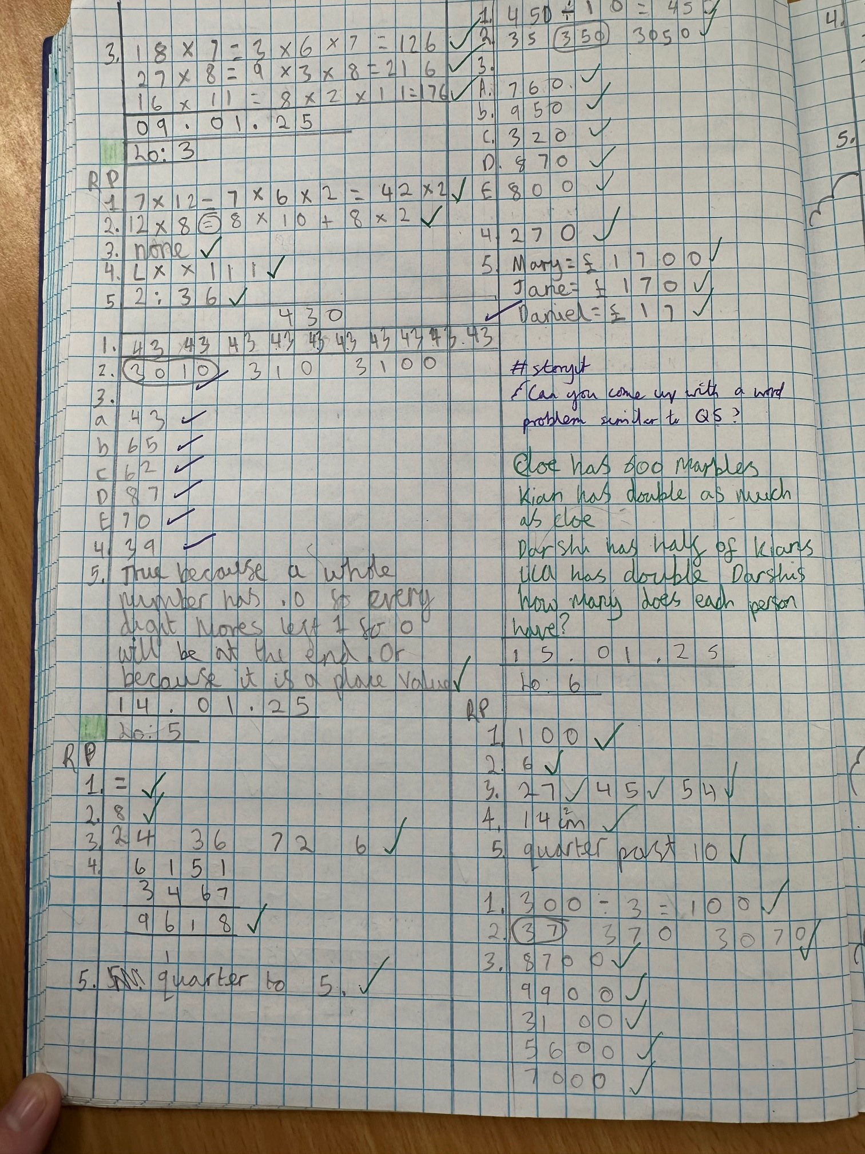
What does Maths look like in Year 4?
Begin to use expanded formal methods for addition and subtraction.
Solve addition and subtraction two-step problems deciding which operations and methods to use and why
Have a secure understanding of number: confidently identifying the value of each digit in a 4 digit number E.g. 2378 the 3 represents 300.
Recognise common groups of equivalent fractions and finding the corresponding decimal.
To solve practical and number problems using reasoning to justify answers.
To confidently and securely know times tables facts, including the inverse up to 12x12
Multiply two-digit and three-digit numbers by a one-digit number using formal written layout

Slide 5
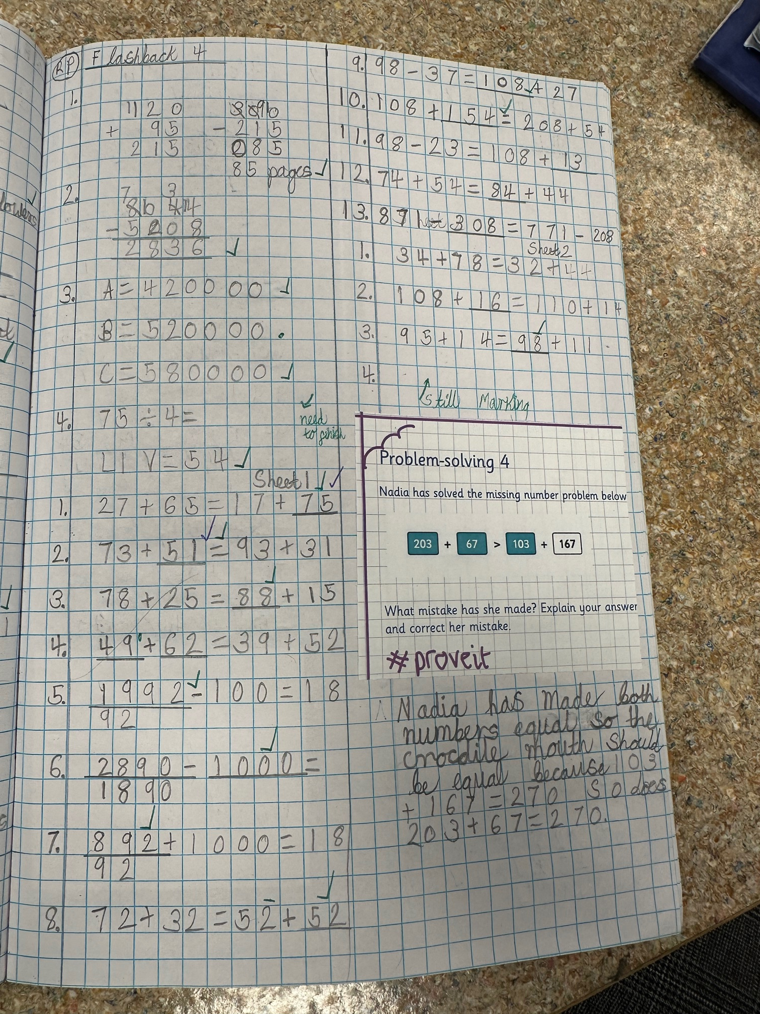
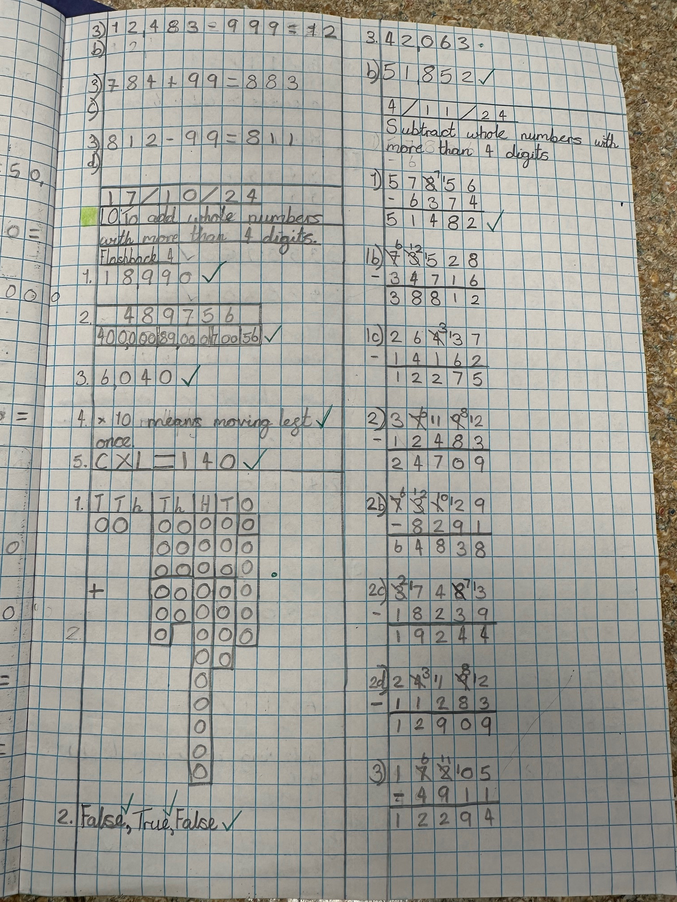
What does Maths look like in Year 5?
Recognise the place value of each digit in numbers with up to 2 decimal places
Measure angles in degrees (°) and draw angles of a given size.
To use the formal written methods for all four operations (addition, subtraction, division and multiplication)
Secure understanding of fractions including simplifying, equivalent fractions and calculating with fractions (+ - and x by integers)
Rapid and accurate recall of ALL times tables and related division facts
Convert between units of measure e.g. grams to kilograms
Draw upon a variety of mental maths strategies to support arithmetic skills
To solve number problems using reasoning to justify my answers and to prove and disprove.
Find non-unit fractions of quantities.

Slide 6
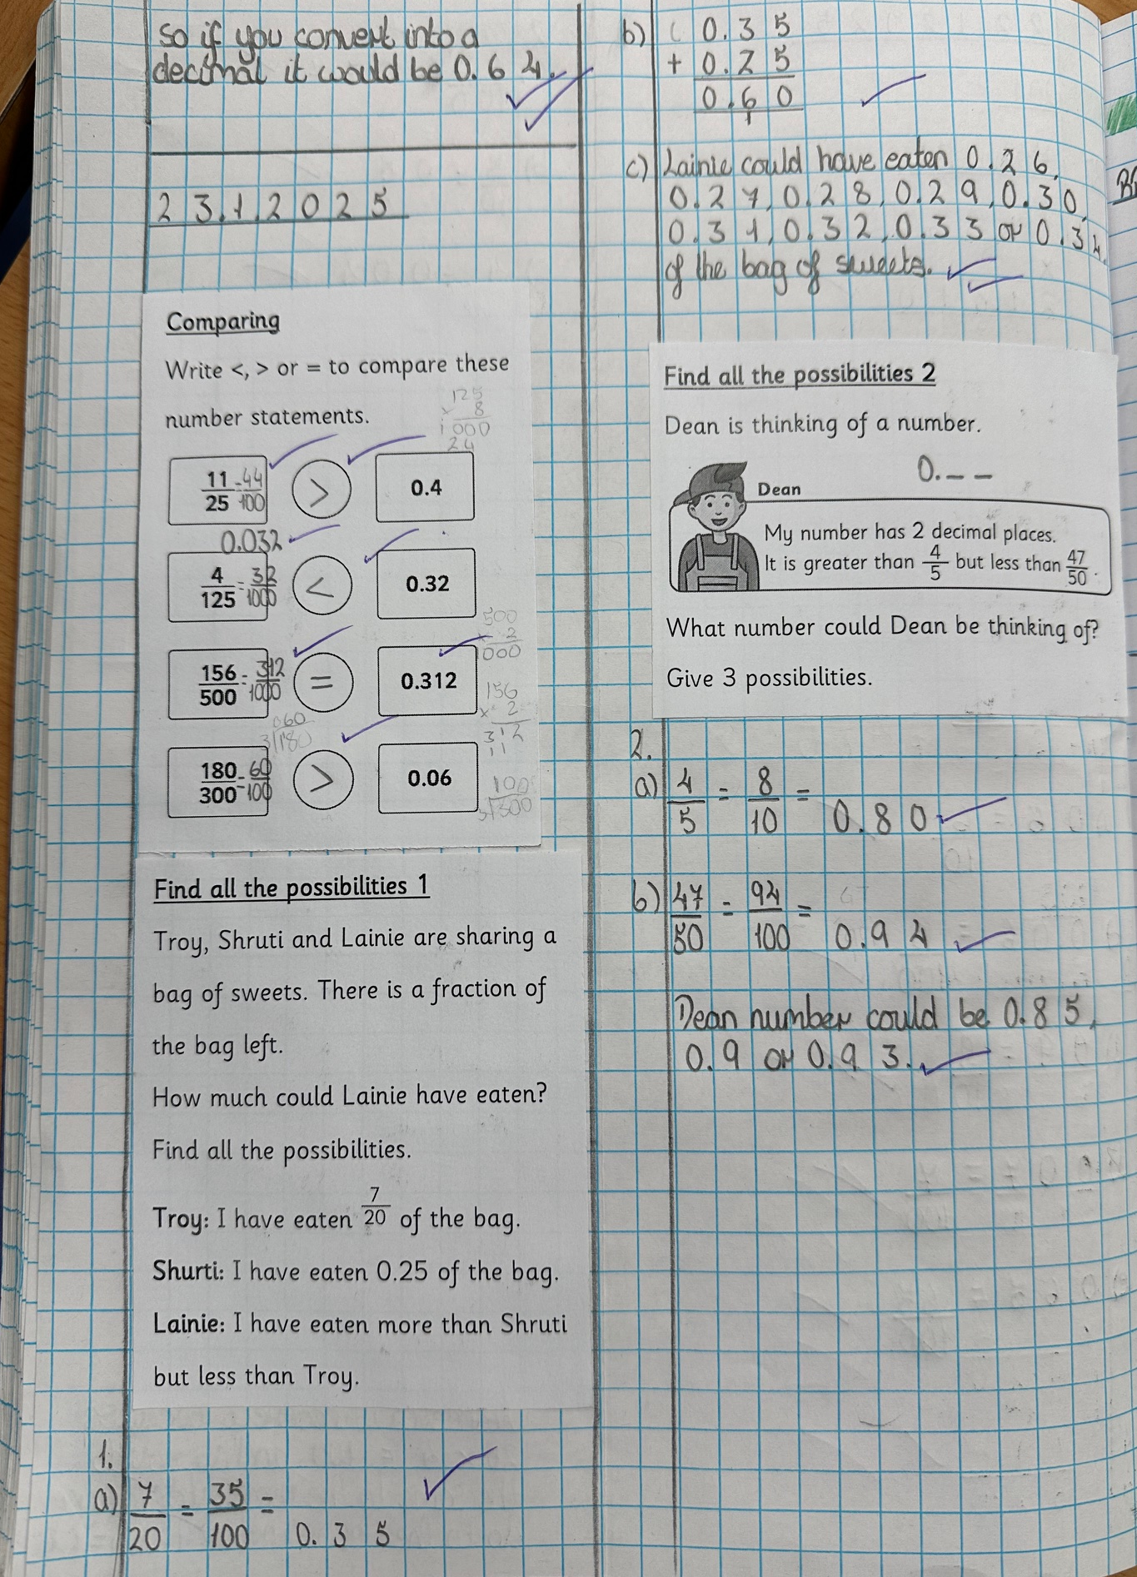
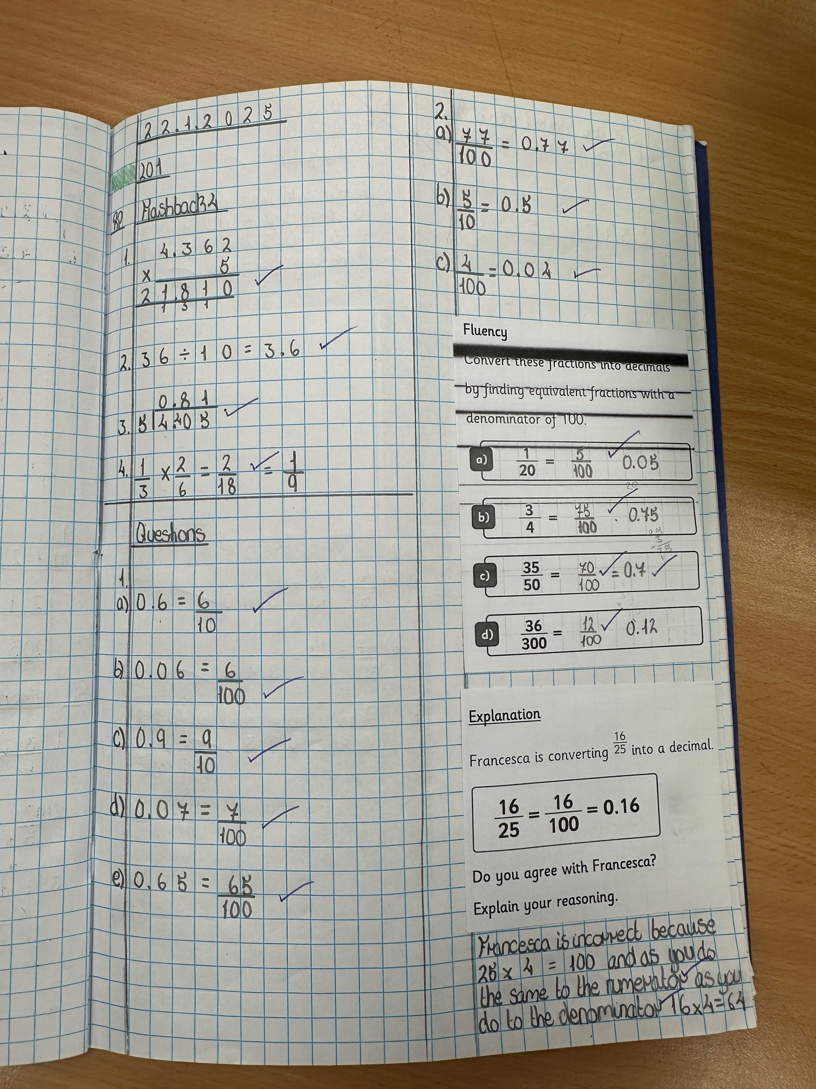
What does Maths look like in Year 6?
Rapid and accurate recall of ALL times tables
Solve multi-step word problems
Recognise the place value of each digit in numbers up to 10 million, including decimal fractions
Draw and compose shapes according to given properties, including dimensions, angles and area
To consolidate the formal written methods and use alongside efficient mental strategies
Use common factors and multiples to simplify fractions. To securely use all four operations when calculating with fractions (+ - x ÷)
Find equivalent fractions, decimals and percentages
Systematic and methodical workings
Draw upon a variety of mental maths strategies to support arithmetic skills

Slide 7
How is maths taught at St Ignatius?
Our curriculum is based on the national curriculum.
We follow White Rose Maths which breaks the national curriculum into small steps.
We use other materials to support the delivery of the curriculum. These include: Third Space Learning, Grammarsaurus and NCETM.

Slide 8


How is maths taught at St Ignatius?
White Rose Maths
Breaks learning into small, sequential steps to build understanding gradually.
Focuses on mastery, where children fully grasp one concept before moving on to the next.
Includes activities for problem-solving, reasoning, and exploring maths in a variety of contexts.
Grammarsaurus Resources
Provides engaging materials to supplement lessons, including interactive games, challenges, and visual aids.
Supports children with different learning styles through creative approaches to maths.

Slide 9
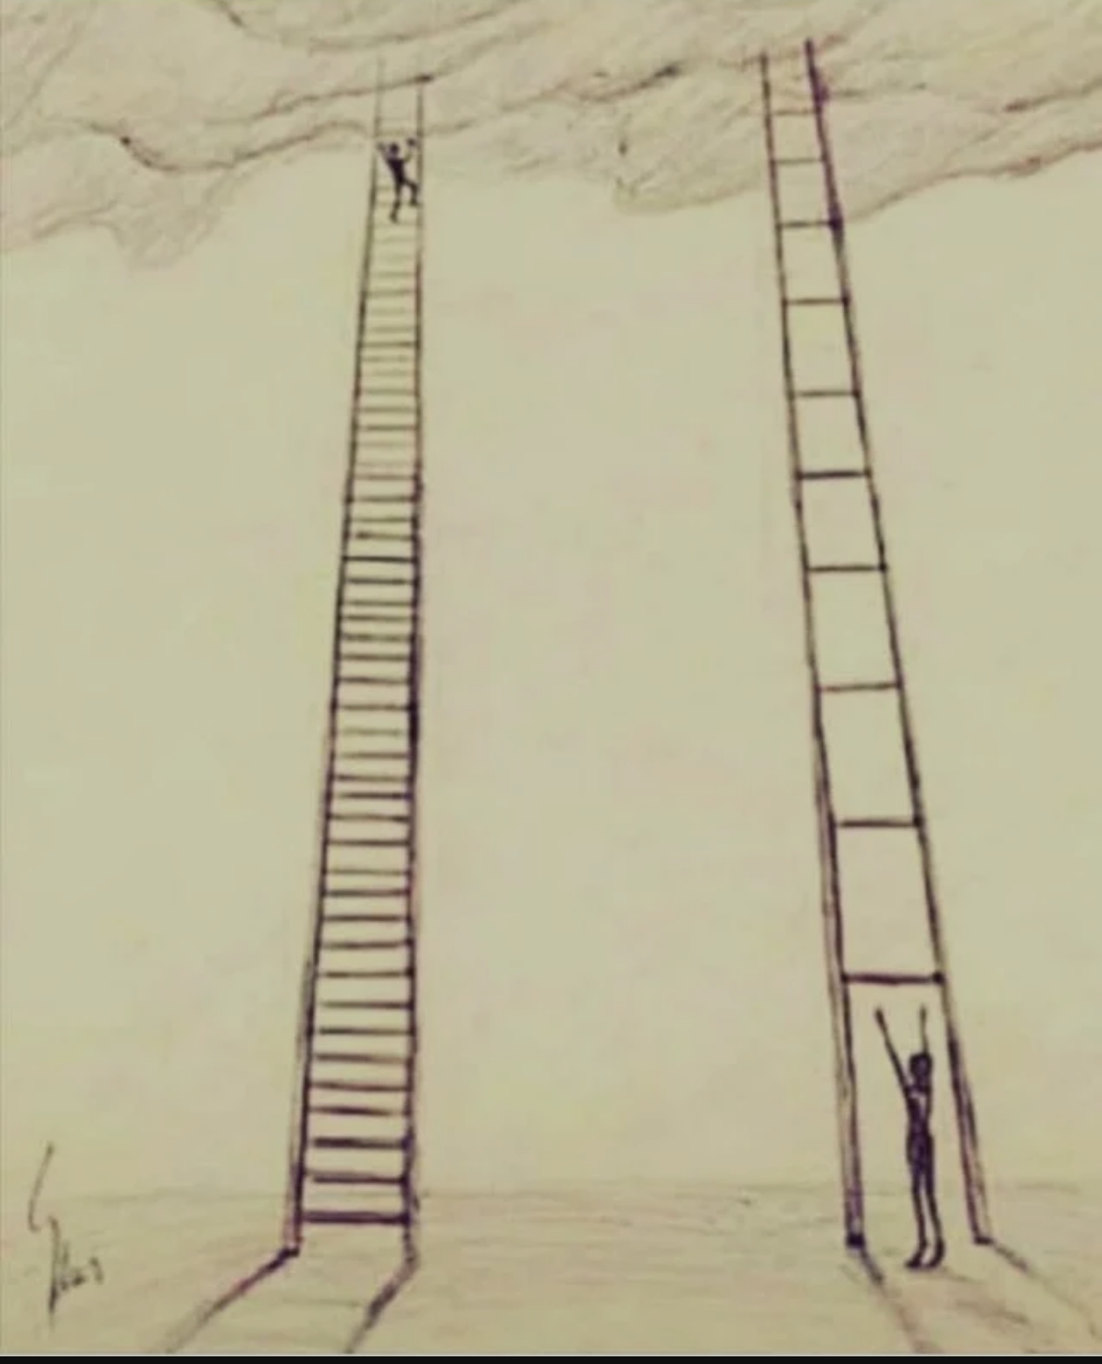

Slide 10
The Mastery Approach
What is the Mastery Approach?
The mastery approach focuses on ensuring all children develop a deep, secure, and long-term understanding of key concepts.
It prioritises building a strong foundation before moving on to new learning.
Learning is broken down into small, manageable steps, with opportunities to revisit and consolidate knowledge.
How Does This Look in Our School?
Whole-class teaching ensures all children are exposed to the same rich content and vocabulary.
We use carefully planned lessons that emphasise reasoning, problem-solving, and fluency.
Pupils are encouraged to explain their thinking, use resources, and work collaboratively.
Support is provided to children who need additional help to meet key objectives.

Slide 11
The Mastery Approach
Why Do We Follow This Approach?
It builds confidence, resilience, and a deeper understanding of concepts.
Ensures that no child is left behind while also offering challenges for those who grasp concepts quickly.
Research shows that mastery improves long-term progress and achievement, setting pupils up for future success.
What Does This Mean for Your Child?
A focus on understanding and enjoyment of learning, not just speed or rote memorisation.
Time to develop critical thinking and problem-solving skills.

Slide 12
Retrieval Practice
Retrieval practice is when children try to remember things they’ve learned before. This helps make their memory stronger and makes it easier for them to use what they know. At St Ignatius, we use FlashBack4 to go over important topics regularly so children don’t forget them. This is important because it helps them feel confident and see how their learning fits together.
We’ll look at an example on the next slide!

Slide 13
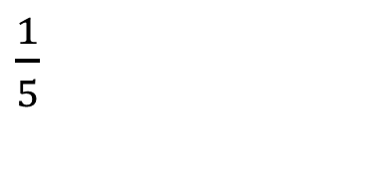
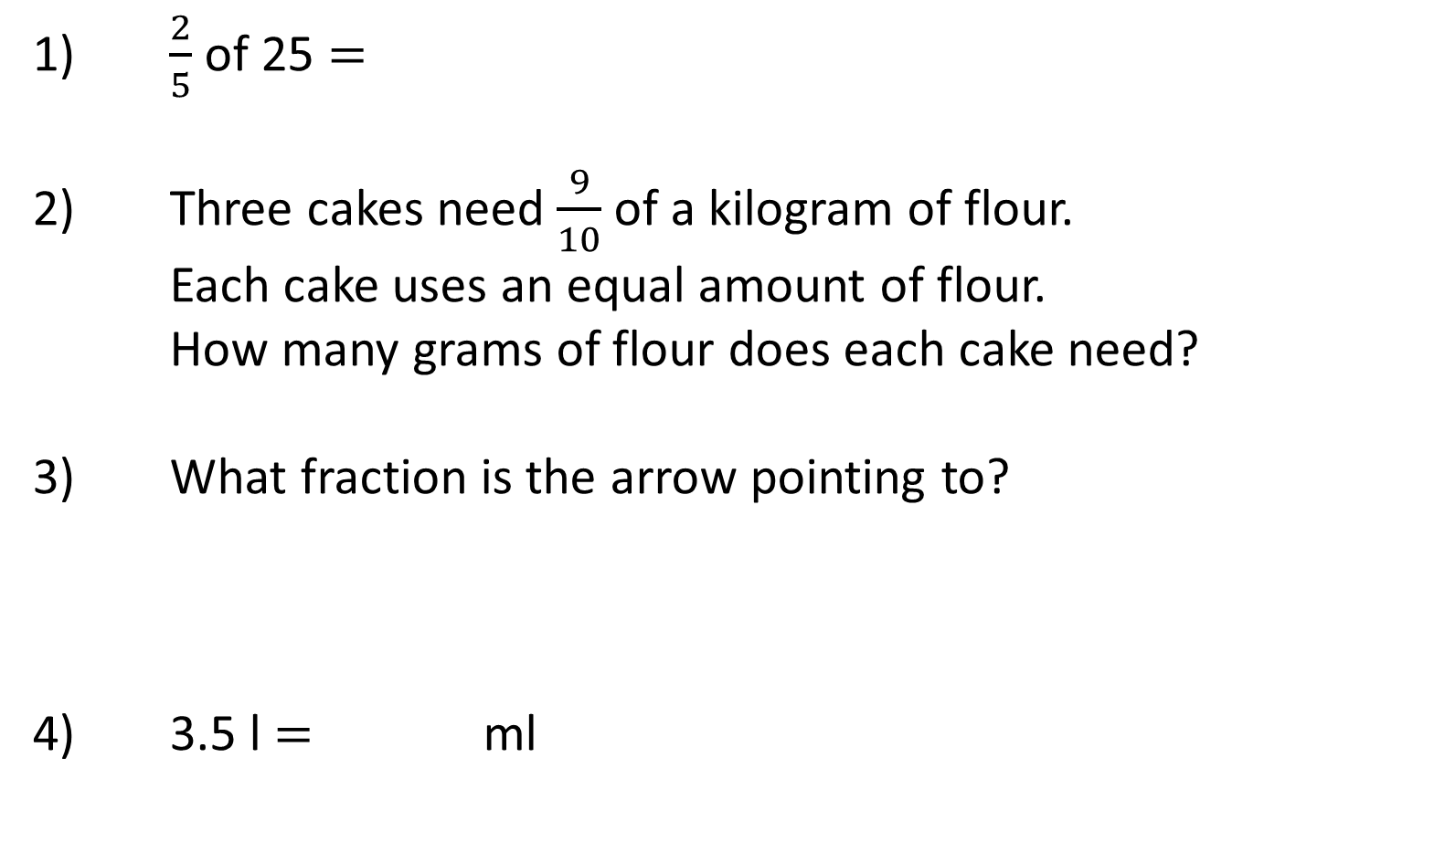
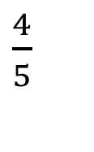
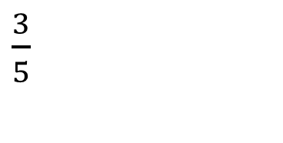
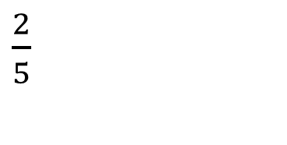
Year 6 | Week 11 | Day 4
CCCIV
1) $\frac{2}{5}$ of 25 $=$
2) Three cakes need $\frac{9}{10}$ of a kilogram of flour.
Each cake uses an equal amount of flour.
How many grams of flour does each cake need?
3) What fraction is the arrow pointing to?
4) 3.5 l $=$ ml
$\frac{1}{5}$
$\frac{2}{5}$
$\frac{4}{5}$
$\frac{3}{5}$
0

Slide 14

Year 6 | Week 11 | Day 4
CCCIV
1) $\frac{2}{5}$ of 25 $=$
2) Three cakes need $\frac{9}{10}$ of a kilogram of flour.
Each cake uses an equal amount of flour.
How many grams of flour does each cake need?
3) What fraction is the arrow pointing to?
4) 3.5 l $=$ ml
10
300 g
$\frac{1}{5}$
$\frac{2}{5}$
$\frac{7}{10}$
$\frac{4}{5}$
$\frac{3}{5}$
0
3,500

Slide 15
Fluency, Reasoning and Problem Solving
Fluency
Maths fluency isn’t just about knowing facts by heart; it’s about understanding numbers and how they work. It combines:
Speed and Accuracy: Quickly recalling number facts (e.g., times tables, addition pairs) and using them correctly.
Flexibility: Choosing the most efficient method to solve a problem and being able to adapt when one approach doesn’t work.
Reasoning
The action of thinking about something in a logical, sensible way.

Slide 16
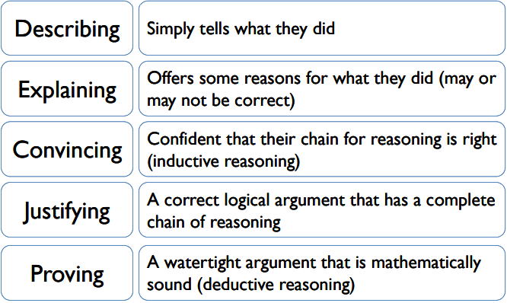
Reasoning
Progression in reasoning

Slide 17
Manipulatives and Resources
Resources can be powerful tools to support sense making, mathematical thinking and reasoning skills.
They help our children to be able to practically engage with new learning and to support their ability to visualise new concepts and knowledge.
We apply a CPA approach to Maths learning which embeds the importance of using physical resources to support learning opportunities.

Slide 18
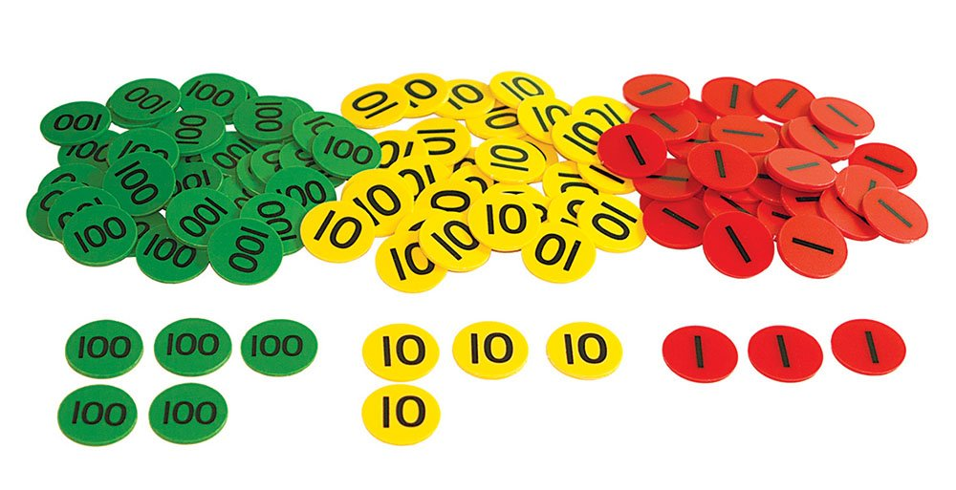
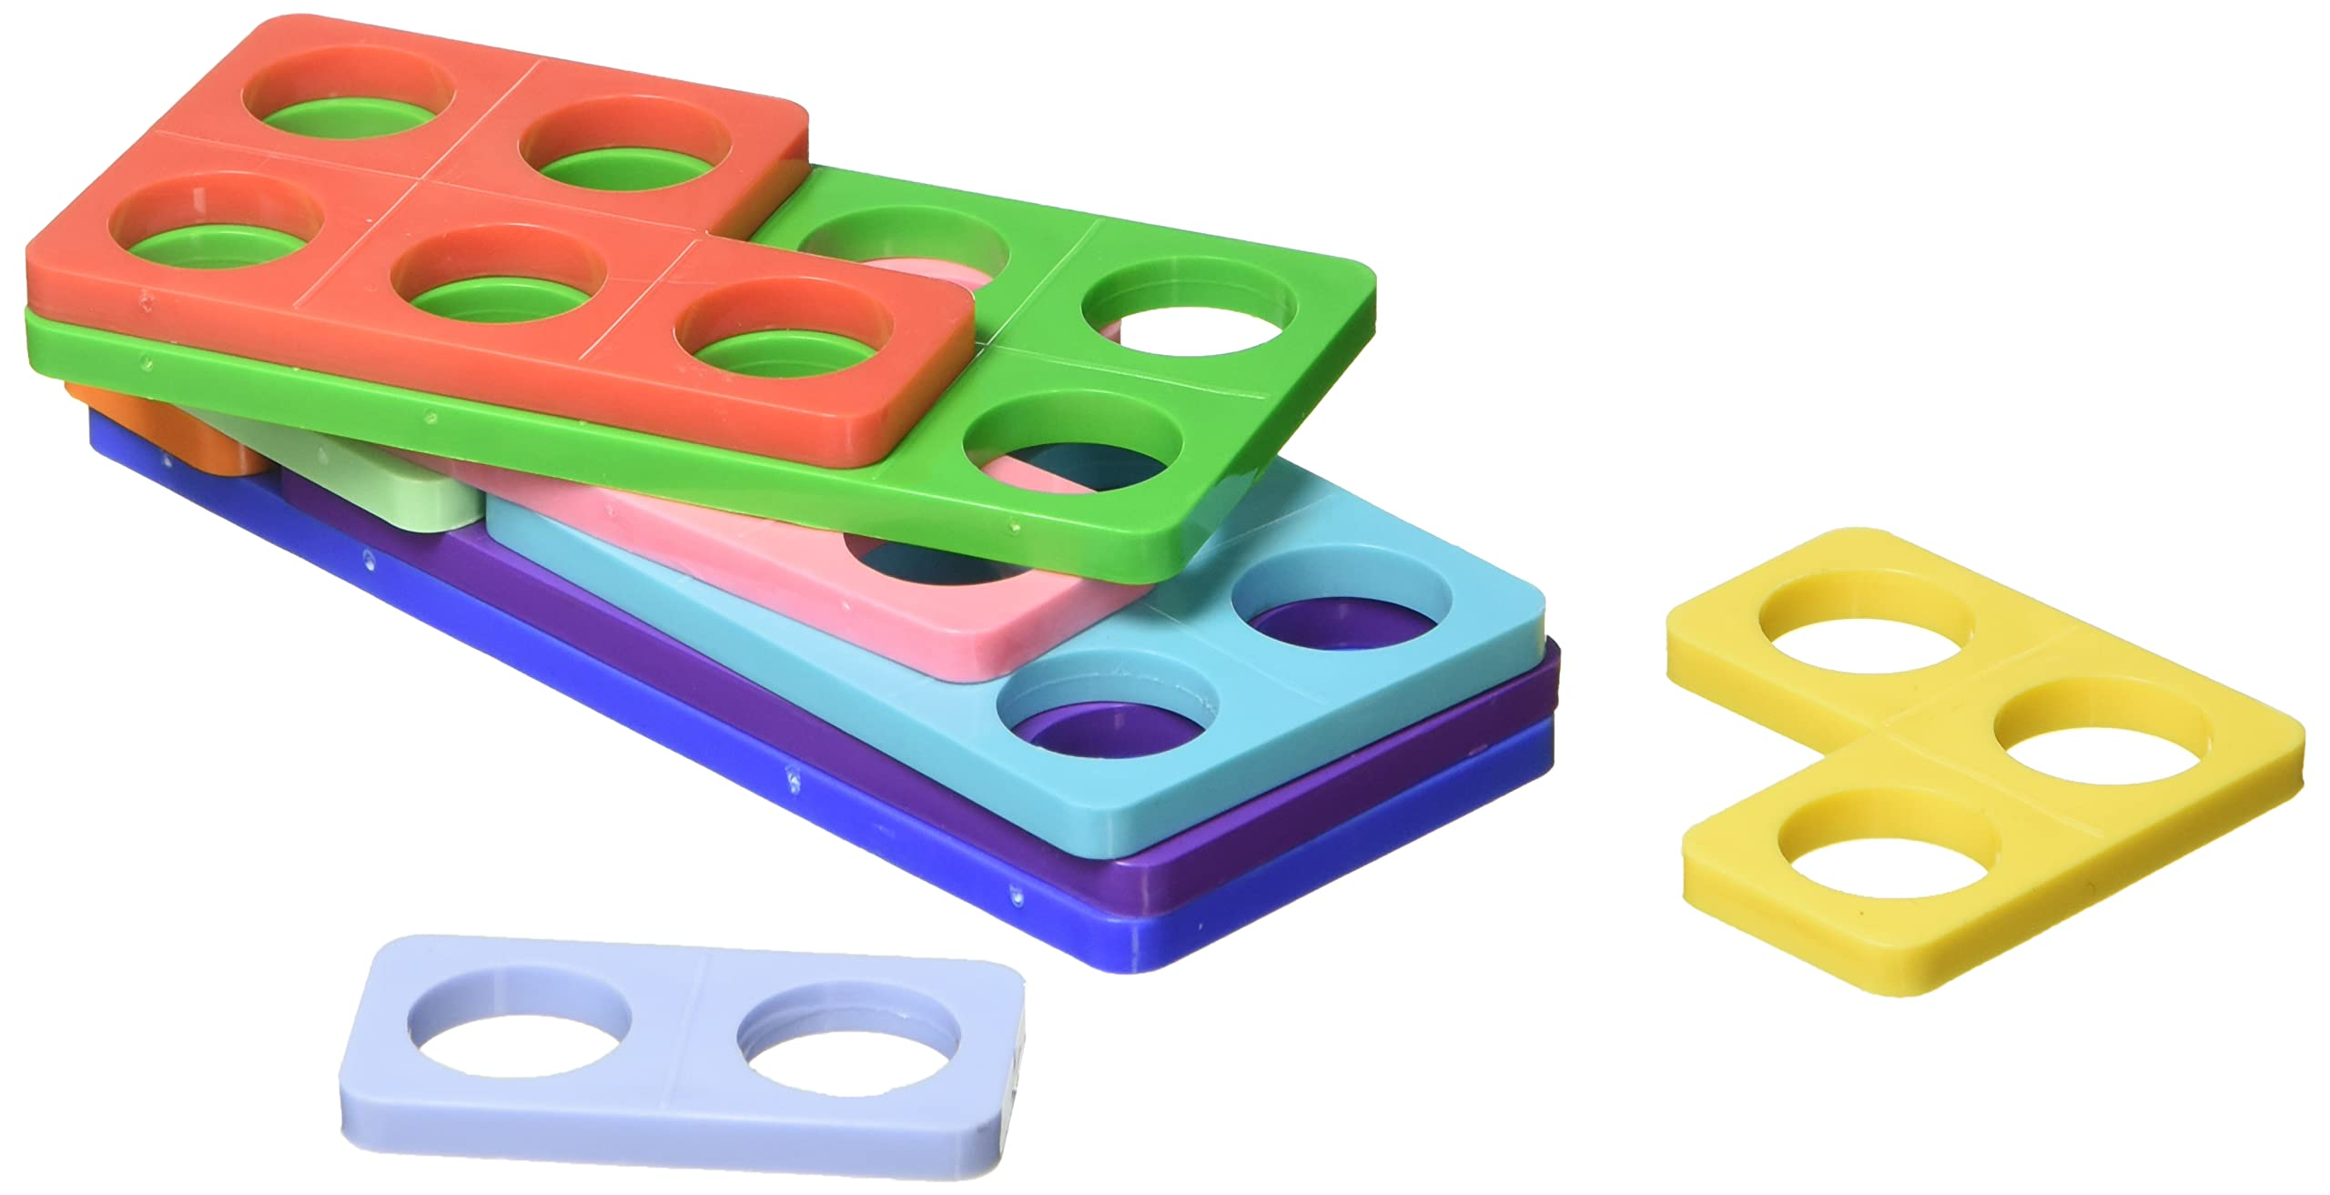
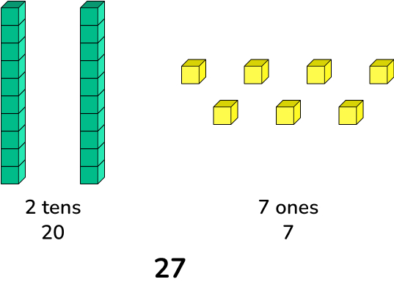
Manipulatives and Resources (CPA)
C is for Concrete.
New concepts are introduced through the use of physical objects or practical equipment. These can be physically handled, enabling children to explore different mathematical ideas. These resources are sometimes referred to as maths manipulatives and can include everyday household items such as straws or dice, as well as specific mathematical tools like Dienes blocks or Numicon.

Slide 19
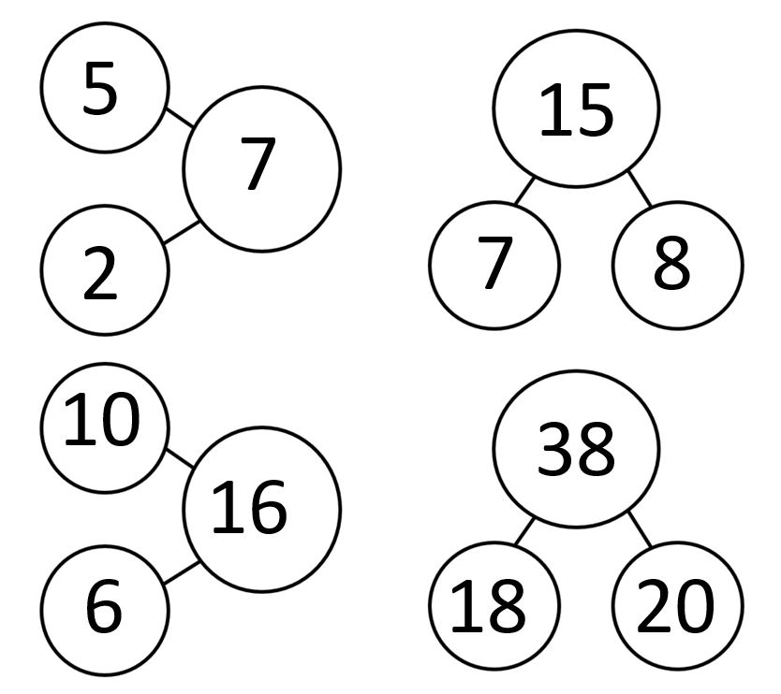
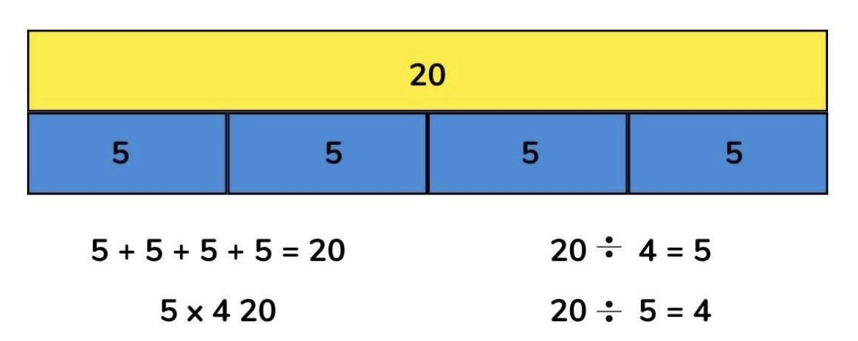
Manipulatives and Resources (CPA)
P is for Pictorial.
Once children are confident with a concept using concrete resources, they progress to pictorial representations. This means they no longer manipulate physical objects but still benefit from the visual support that these representations provide.

Slide 20
Manipulatives and Resources (CPA)
A is for Abstract.
When children have a secure understanding of the concept through concrete resources and visual images, they move on to the abstract stage. Here, children use symbols, such as numbers and mathematical notations, to solve problems. To access this stage effectively, children need continued access to the previous two stages alongside it.
5 x 4 =
4 + 4 + 4 + 4 + 4 =

Slide 21
Questioning and Talk
Good questions, and equally important, good listening can help children make sense of mathematics, build their confidence, and encourage mathematical thinking and communication. A good question opens up a problem and supports different ways of thinking about it. Some questions to try while helping a child might include:
What do you already know about this?
What do you need to find out?
How might you begin?
How can you organise your information?
Can you draw a picture to explain your thinking?
Are there other possibilities?
What would happen if …?
What do you need to do next?

Slide 22
How can you help your child at home?
Encouraging a Positive Approach to Maths
Take Away Their Fear:
Help your child feel confident and at ease with maths by creating a supportive environment.
Reassure and Praise:
Offer encouragement and praise whenever possible to build a positive mindset.
Play with Numbers and Shapes:
Incorporate games that involve numbers and shapes to make learning fun and interactive.
Embrace Mistakes as Learning Opportunities:
Encourage your child to see mistakes as valuable opportunities to learn. Use them as discussion points to explore new ideas and approaches.

Slide 23
How can you help your child at home?
Connecting Mathematics to Real-Life Experiences
Helping children connect mathematics to their everyday lives makes maths education more engaging and relevant. By recognising the importance and value of mathematics in real-world situations, we can inspire curiosity and confidence in solving practical problems. For example:
Managing Money When Shopping:
If I buy multiple items, how can I estimate the total cost?
How much change will I receive if I pay with a £10 note?
Comparing Prices and Making Smart Choices:
At the petrol station, how much do I save if I buy 9 litres of petrol at £1.69 per litre instead of 9 litres at £1.71 per litre?

Slide 24
How can you help your child at home?
Incorporating Maths into Everyday Activities
Using Food Packaging to Explore Shapes:
Food packaging is a great resource for discussing 2D and 3D shapes. Ask your child about the properties of these shapes, such as the number of faces, sides, and vertices. Take it a step further by flattening the packaging to explore the net of the 3D shape.
Playing Maths-Related Board Games:
Board games offer endless opportunities to practise maths in a fun and engaging way. Games like Snakes and Ladders, Monopoly, Bingo, Connect Four, and Battleships help reinforce mathematical concepts like counting, strategy, and probability.

Slide 25
How can you help your child at home?
Incorporating Maths into Everyday Activities
Practising Telling the Time:
Work with your child to improve their time-telling skills. Can they read both digital and analogue clocks? Can they convert between the two and use the 24-hour clock? Encourage them to recognise Roman numerals on clocks as well for an extra challenge.
Exploring Time with the TV Guide:
When flicking through the TV guide, ask your child to calculate the length of their favourite programmes. How long will it be until the next programme starts? This activity helps improve their ability to work with time in a practical context.

Slide 26
Times Tables
Times tables are incredibly important.
They will help children to solve problems that involve…
Long multiplication
Fractions
Percentages

Slide 27
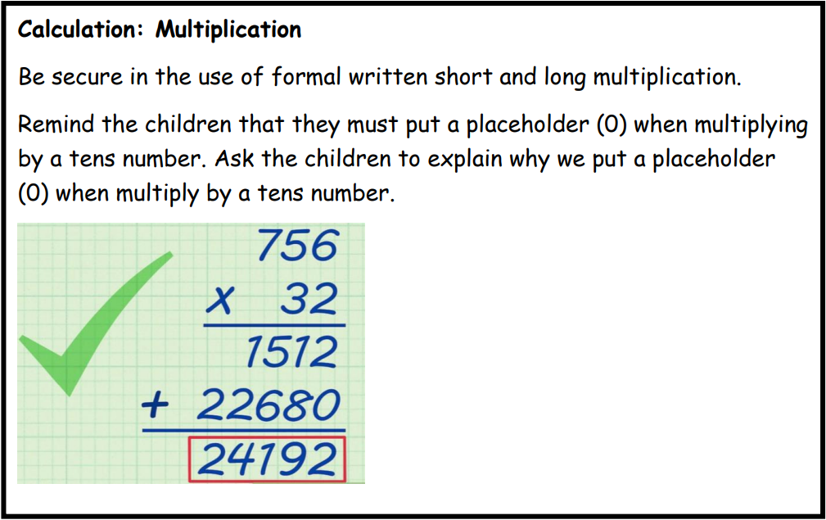
Times Tables
Long multiplication

Slide 28
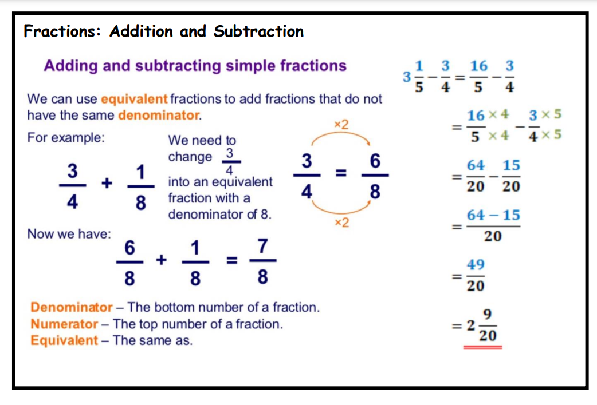
Times Tables
Fractions

Slide 29


Times Tables Rockstars (TTRS)
When it comes to times tables, speed AND accuracy are important - the more facts your child remembers, the easier it is for them to do harder calculations. Times Table Rock Stars is a fun and challenging programme designed to help students master the times tables. World Famous musicians need to practice and so do children with their tables!
One way we will be looking to boost the use of TTRS is by introducing different competitions.

