Slide 1

Welcome

Slide 2
Agenda
To share with parents what life will be like this year.
To share ways in which we can work together to get the very best outcome for the children.

Slide 3
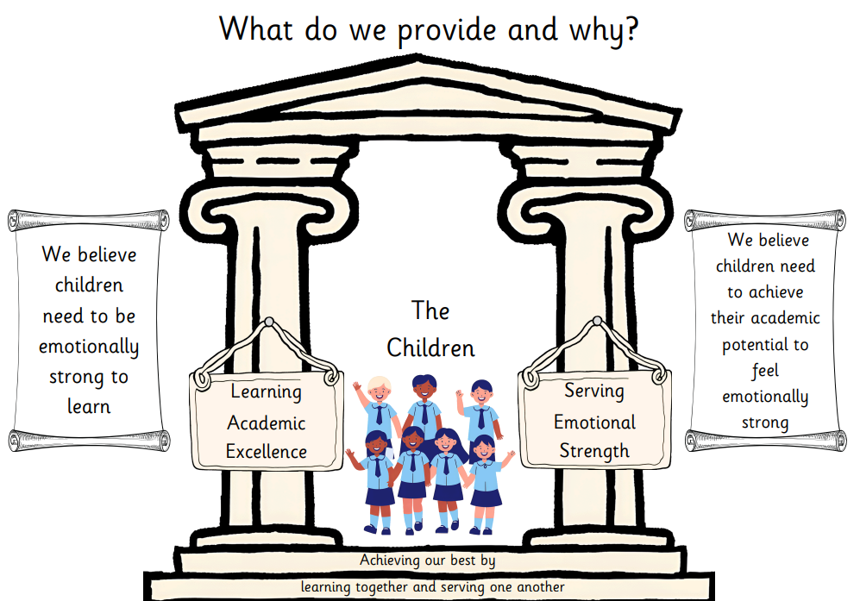

Slide 4
Who are we?- The Team!
St Teresa : Mrs. Whittington and Mrs Barkworth
St Margaret: Miss. Partington
Mrs. Barnard

Slide 5
SAFEGUARDING- Everyone's responsibility
The Designated Safeguarding Lead (DSL) at St Ignatius Primary School is Mrs E. O’Neill (Deputy Headteacher).
Deputy Designated Safeguarding Leads are:
Mrs H. Murphy
Miss T. Frew
No child should suffer harm, either at home or at school. Everyone who works in our school has a responsibility to make sure that all our young people are safe.
If you are worried about the safety of your child or any young person in our school, you must report this to the DSL.

Slide 6
This year, our focuses are..
Building up handwriting stamina
Fluency in mathematics
Building up a love of reading
Enjoying a varied, challenging curriculum
Embedding great learning behaviours
To really enjoy coming to school

Slide 7

CURRICULUM
St Ignatius offers a challenging and exciting curriculum which provides the opportunity for children to develop a thirst for learning.
We strive to develop life long learners.
We develop both knowledge and skills across a wide range of learning areas.
We use knowledge organisers to support learning and the partnership between school and home.

Slide 8
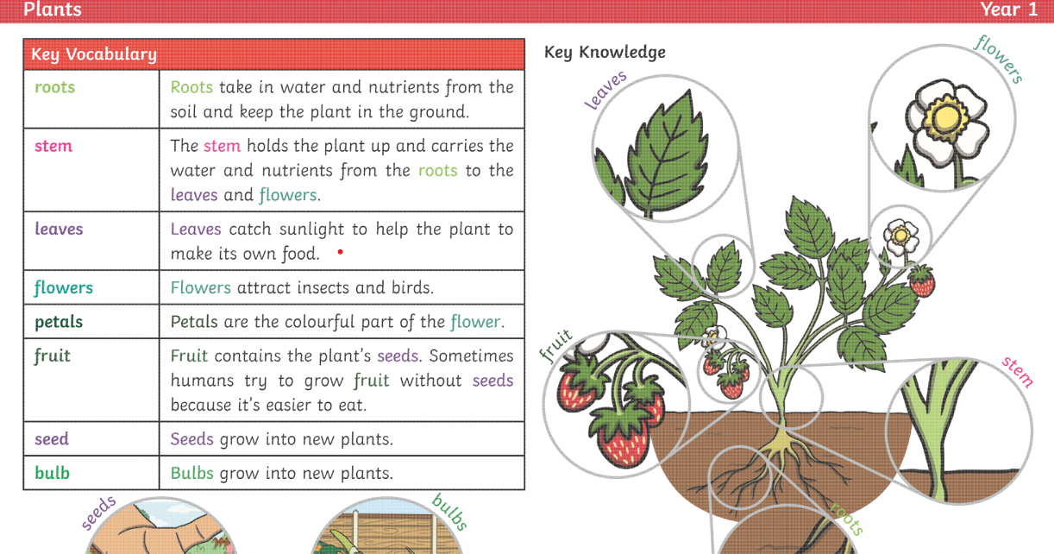
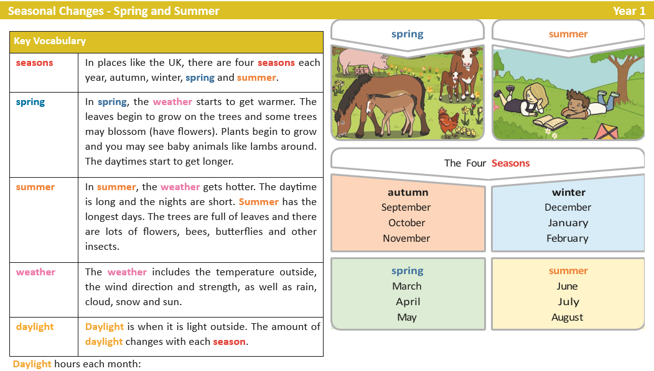

Slide 9
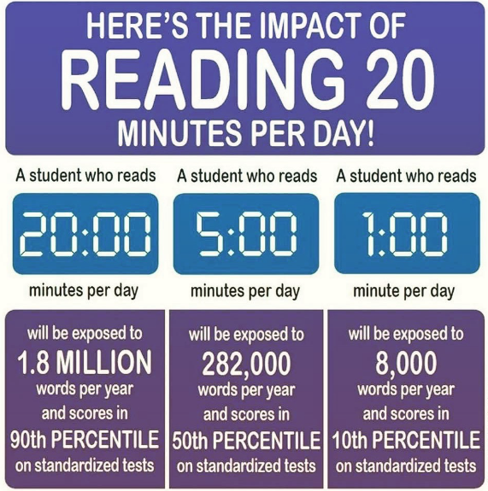
Reading impacts life chances!!
At St. Ignatius we promote reading through everything we do. We provide regular opportunities for the children to read throughout the school day and we also expect the children to read daily at home.
These are some of the main reasons why:
Reading helps build communication skills
Reading opens the imagination
Reading has a positive impact on progress at school
Reading can improve mental health and wellbeing
Reading is a fundamental life skill

Slide 10

Behaviour- Development of values
Notes:
We will focus on living the values. Rewards will be based on values. When children break values we will use restorative approaches.

Slide 11

PE and Homework
Our PE days are: Tuesday and Friday (Swimming)
Homework will be sent out on Wednesday and returned on Monday
Please make sure hair is tied back, especially PE days and earrings are removed.

Slide 12

COMMUNICATION
Information
Newsletters will be monthly from Headteacher.
Parentmail is the main source of communication. If your email address has changed please let the office know.
Class Email - classname@st-ignatius.surrey.sch.uk
Contact
Individual Parent’s Evenings in Autumn and Spring Term
If you need to see us at any time, please arrange an appointment, or email your child’s class teacher via the class email.
Please speak to your child’s teacher in the first instance, and then a member of the Leadership team. If you would like to discuss the matter further, please then arrange an appointment with the Headteacher.

Slide 13

Attendance is vital!!!
Absence from school has a hugely significant impact on children’s progress and attainment, their social development and their wellbeing.
Our school analysis of attendance and punctuality demonstrates strong links between high attendance and good progress and attainment.
Please be aware that requests for taking children out of school during term time will NOT be authorised, unless circumstances are highly exceptional. 5 days unauthorised will result in a fine. (New guidance August 2024)
We understand, of course, absence is unavoidable in the case of sickness and very exceptional family circumstances.

Slide 14

MEDICAL INFORMATION
Please ensure we are kept up to date with any medical matters which may affect your child at school. If your child has a medical condition please inform the school so that we can put appropriate care plans in place.
We are happy to administer medicines to children. Please collect a form from the office which will detail how and when the medicine needs to be administered and your consent for a member of staff to do so.
Please make sure that all inhalers are in date.
If your child is injured (e.g. broken arm, using crutches) it may require the school to create a Risk Assessment for them. Please email the office with detailed information about the condition, time period for recovery and any changes needed to access the school safely so a Risk Assessment can re written before your child returns to school.
If in doubt, check at the office.
As we have many children with allergies to different foods, we ask you not to send sweets or other treats for birthdays. Consider buying the whole class one small book for their library area if you wish to.

Slide 15

E-SAFETY
We explicitly teach strategies for the children to remain safe online and to follow the principles of safe online conduct. We are constantly vigilant about the safety of their online activities at school. Please ensure parental settings on home computers, ipads etc are robust and secure. If your child is using an online device, try to ensure you can see what they are watching or playing at all times.
For further information: www.thinkuknow.co.uk ; www.breckfoundation.org.uk

Slide 16
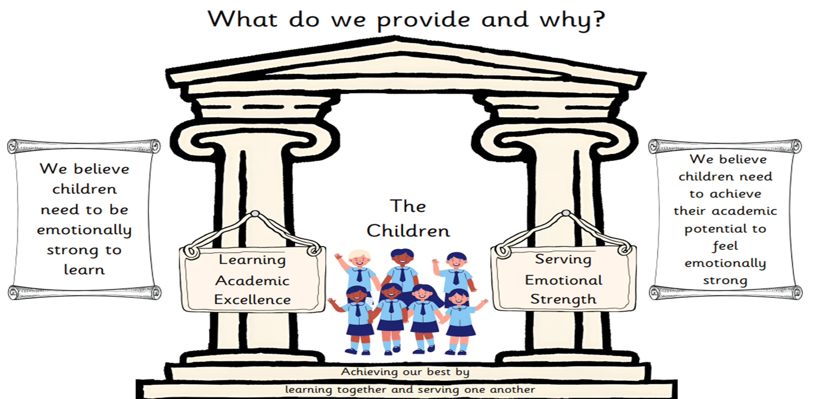
Final words…..
We look forward to working with you and your child
We are here to support and help
Children who receive help from home do better
We care dearly about our children and they will be loved
Thank you very much for coming today

