Slide 1
RSE in our School

Slide 2

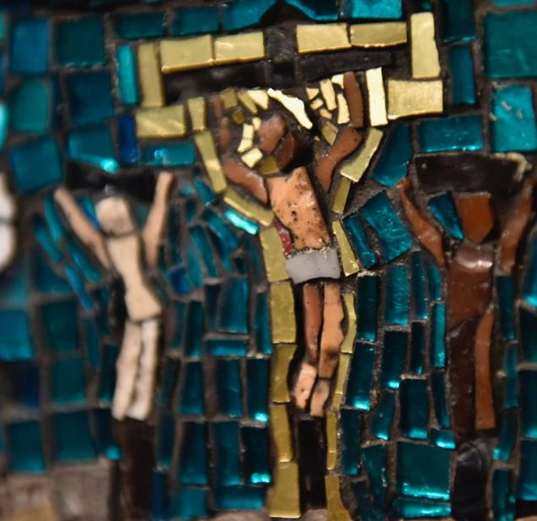
Prayer
Father,
Thank you for your great love for us. You sent your only
Son to live with us and show us how to love.
As we explore teaching about relationships to the young people in our school, help us to keep them and Christ at the centre of our minds.
May The Holy Spirit bring us wisdom and peace in guiding our conversations.
We commend to you our words and actions. Amen

Slide 3

To explore why RSE is important.
To share the statutory requirement of RSE
in primary schools.
Objectives:
To share the Curriculum and supporting documents from the Catholic Education
Service.
To outline how to support your child
through use of the Parent Portal and Parent Consultation Tool.

Slide 4
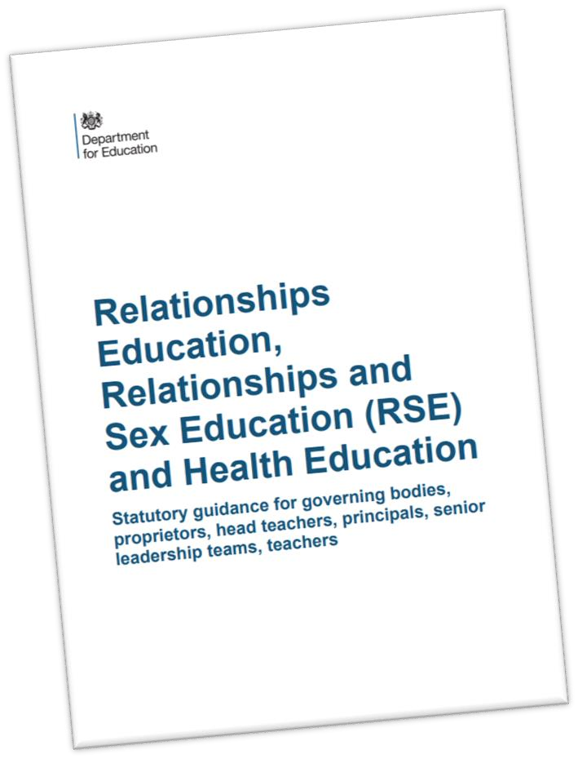
Statutory RSE
In 2020 Relationships Education and Health Education became statutory in all primary schools in England.

Slide 5
Understanding their value and the values of others.
Instilling confidence and self-esteem.
Reliable, correct information in a safe
learning environment
Knowing how to keep safe.
Helping with peer pressure.
Why teach RSE?
Learning how to make sensible and informed
decisions in a changing cultural climate.
Understanding the positive impact of loving God, self, neighbour and our common home.

Slide 6

Vision for Relationship and Sex Education in Westminster Catholic Schools
It is our vision for Relationship and Sex Education in Catholic Schools in the Diocese of Westminster
that pupils would learn in light of the wisdom of
the Church.
how to foster healthy relationships and friendships
Pupils will flourish when they truly understand their innate human dignity, love and appreciation of themselves, including respect for their bodies, and the way they were made by God.
Pupils will learn to make in a changing cultural climate, focussing on
sensible and informed decisions
the virtues, such as patience and chastity, that ultimately lead to true happiness.
Sacred Scripture is key to this vision and the message Jesus gave us to love God, self, neighbour and
our common home.
RSE in our schools must always remain faithful to the teaching of the Church, recognising the
diversity of pupils’ situations. We aim to be sensitive to each individual, ensuring that their
physical
and emotional well-being
and their safety are of paramount importance.

Slide 7
Primary Relationships Education
Relationships Education will put in place the building blocks needed for positive and safe relationships, including with family, friends and online.
Your child will be taught what a relationship is, what friendship is, what family means and who can support them.
In an age-appropriate way, your child’s school will
cover how to treat each other with kindness,
By the end of primary school, pupils will have been taught content on:
families and people who
care for me
caring friendships
respectful relationships
online relationships
being safe
consideration and respect.
You can find further details by searching ‘relationships, sex and health education’ on GOV.UK.

Slide 8
Primary Health Education
Health Education aims to give your child the information they need to make good decisions about their own health and wellbeing, to
recognise issues in themselves and others, and to seek support as early as possible when issues arise.
By the end of primary school, pupils will have been taught content on:
mental wellbeing
internet safety and harms
physical health and fitness
healthy eating
facts and risks associated with drugs, alcohol and
tobacco
health and prevention
basic first aid
changing adolescent body
(The science curriculum in all primary schools also includes content on human development, including reproduction, which there is no right to withdraw from.)
You can find further details by searching ‘relationships, sex and health education’ on GOV.UK.

Slide 9
As a Catholic school, our mission is to support the spiritual, moral, social and cultural development of all of our pupils,
Our mission as a School
rooted in the wisdom and teaching of the
Church.
The education of children in human
sexuality is an important, precious and privileged responsibility.

Slide 10


How do we teach RSE at St Ignatius?
At St Ignatius we are following Life to the Full by Ten
Ten Resources.
Ten Ten is a Catholic educational organisation and is the recommended resource by our diocese.
Ten Ten entered into a partnership with the Catholic Education Service and the Department for Education to provide training for teachers in Catholic schools. We have used the resource since 2020.
Therefore, this programme is a very good fit for our school.

Slide 11


Our RSE Curriculum
The Relationships and Health Education sessions will be taught across three modules:
Spring 1 - Relationships Education - Created to love others: Personal Relationships
Summer 1 - Relationships Education - Created to love others: Keeping Safe
Summer 2 - Health and Well-Being - Created and Loved by God: Me My Body, My Health, Emotional Well-Being and Life Cycles

Slide 12

Our RSE Curriculum:
Our Relationships and Health curriculum will be taught as a spiral curriculum. This means that the same modules and units are covered every single year throughout the programme. Each module is taught within each phase and then personalised/built upon each year to suit the individual needs of the class.

Slide 13
Our RSE Curriculum
Reception
 | Spring 1 Relationships Education | Summer 1 Relationships Education | Summer 2 Health and Well-Being
Overarching Themes | Module 2: Created to Love Others: Personal Relationships | Module 2 contd: Created to Love Others: Keeping Safe | Module 1: Created and Loved by God: Me My Body, My Health, Emotional Well-Being, Life Cycles
 | 1.Role Model (Unit 1) | 1. Safe Inside and Out | 1. I Am Me (Unit 2)
 | 2. Who’s Who? (Unit 1) | (Unit 4) | 2. Heads, Shoulders, Knees and Toes
 | 3. You’ve Got A Friend in Me | 2. My Body, My Rules | (Unit 2)
 | (Unit 2) | (Unit 4) | 3. Ready Teddy (Unit 2)
 | 4.Forever Friends (Unit 2) | 3. Feeling Poorly (Unit | 4. I Like, You Like, We All Like! (Unit 3)
 |  | 4) | 5. Good Feelings, Bad Feelings (Unit 3)
 |  | 4. People who Help Us | 6. Let’s Get Real (Unit 3)
 |  | (Unit 4) | 7. Growing Up (Unit 4)

Slide 14
Our RSE Curriculum
Year 1 and 2
 | Spring 1 Relationships Education | Summer 1 Relationships Education | Summer 2 Health and Well-Being
Overarching Themes | Module 2 Created to Love Others: Personal Relationships | Module 2 contd: Created to Love Others: Keeping Safe | Module 1: Created and Loved by God: Me My Body, My Health, Emotional Well-Being, Life Cycles
 | God Loves You (Unit 1) Special People (Unit 2) Treat Others Well… (Unit 2) 4…And Say Sorry (Unit 2) | Being Safe (Unit 4) Good Secrets and Bad Secrets (Unit 4) Physical Contact (Unit 4) Harmful Substances (Unit 4) Can you Help Me? (Unit 4) | Year 1 1.I am Unique (Me) (Unit 2) Girls and Boys (Unit 2) Clean and Healthy (Unit 2)
 |  |  | Year 2 Feelings, Likes, Dislikes (Unit 3) Feelings, Inside and Out (Unit 3) Super Susie Gets Angry (Unit 3) The Cycle of Life (Unit 3)

Slide 15
 | Our RSE Curriculum Year 3 and 4
 |  | Spring 1 Relationships Education | Summer 1 Relationships Education | Summer 2 Health and Well-Being
Overarching Themes |  | Module 2 Created to Love Others: Personal Relationships | Module 2 contd: Created to Love Others: Keeping Safe | Module 1: Created and Loved by God: Me My Body, My Health, Emotional Well-Being, Life Cycles
 |  | Friends Family and Others (Unit 2) When Things Feel Bad (Unit 2) | Sharing Online (Unit 3) Chatting Online (Unit 3) Physical Contact (Unit 4) Drugs, Alcohol, Tobacco (Unit 4) First Aid Heroes (Unit 4) | Year 3 We Don’t Have To Be The Same (Unit 2) Respecting Our Bodies (Unit 2) What Am I Feeling? (Unit 3) What Am I Looking At? (Unit 3) I Am Thankful! (Unit 3)
 |  |  |  | Year 4 What is Puberty? Changing Bodies Life Cycles

Slide 16
 | Our RSE Curriculum Year 5 and Year 6
 |  | Spring 1 Relationships Education | Summer 1 Relationships Education | Summer 2 Health and Well-Being
Overarching Themes |  | Module 2: Created to Love Others: Personal Relationships | Module 2 contd: Created to Love Others: Keeping Safe | Module 1: Created and Loved by God: Me My Body, My Health, Emotional Well-Being, Life Cycles
 |  | Is God Calling You? (Unit 1) Under Pressure: Do You Want A Piece of Cake? (Unit 2) 4. Self-Talk (Unit 2) | Sharing Isn’t Always Caring (Unit 3) Cyberbullying (Unit 3) Types of Abuse (Unit 4) Impacted Lifestyles (Unit 4) Making Good Choices (Unit 4) Giving Assistance (Unit 4) | Year 5 Gifts and Talents Girls Bodies Boys Bodies Spots and Sleep
 |  |  |  | Year 6 Body Image Peculiar Feelings Emotional Changes Making Babies (Part one) Menstruation

Slide 17


Slide 18
Key Decisions: Consistent Vocabulary
As recommended by the Diocese, we use the scientific terms below to describe the genitalia. These terms will be introduced at Key Stage one and will be used throughout the school.
The terms we will use are the penis, testicles, vagina and vulva.
Our rationale for using these terms is as follows:
Firstly when we discuss the differences between boys and girls, it is important not to uphold negative gender stereotypes. The non-physical differences between boys and girls at this age are small and difficult to define. By linking gender to biological sex, it helps children to understand the difference, equality and complementarity of boys and girls.
Secondly this is a safeguarding issue. Younger children are better able to confidently articulate about private body parts, they are better equipped to identify experiences of feeling uncomfortable if any form of abuse takes place.

Slide 19
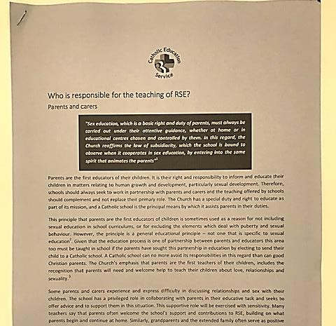
Who is responsible for teaching RSE?
‘Parents are the first educators of their children’
Governors
Headteacher
Teachers and other staff
Visitors and external speakers
Parish and diocese

Slide 20

DfE- Parents rights
The important lessons you teach your child about
healthy relationships, looking after themselves and
staying safe, are respected and valued under this new
curriculum.
Teaching at school will complement and reinforce the lessons you teach your child as they grow up.
Your child’s school is required to consult with you when developing and renewing their policies on Relationships Education. These policies must be published online and be available to anybody free of charge.
You can express your opinion, and this will help your child’s school decide how and when to cover the content of the statutory guidance. It may also help them decide whether to teach additional non- statutory content.
Schools are required to ensure their teaching reflects
the age and religious background of their pupils.

Slide 21
Parent Portal
Ten Ten understand the foundational role that parents have in educating and nurturing
their children on these matters. Within the programme, they have built in resources
which will not only keep you informed about what is being taught in school, but will also give you the opportunity to engage your children in discussion, activity and prayer.
To engage with the teaching and deepen the experience for your child, Ten Ten have
provided a Parent Portal that provides:
Information about the programme we will be following
Access to the teaching resources
Suggestions for further activity at home
To access the online parent portal please visit: www.tentenresources.co.uk/parent-portal
School Username: r.vandervloet@st- ignatius.surrey.sch.uk School Password: Stigs@sunbury

Slide 22
Parent Consultation Tool
Ten Ten have also provided an online Parent Consultation Tool. This is a simple-to-follow, short
online course which:
Outlines the statutory changes that will take place.
Articulates a vision for Catholic Relationships and Health Education.
Explains how Life to the Full aims to help us fulfil the statutory curriculum with a Catholic ethos.
Answers some Frequently Asked Questions.
To take part in the consultation, please do the following:
Access the Parent Consultation Tool here: www.tentenresources.co.uk/parent-consultation-
primary
Use the school’s login credentials
Undertake the Parent Consultation course and follow the instructions provided.
We will send out a survey this week for you to complete also.

Slide 23

DfE - Right to withdraw your child- Primary
You cannot withdraw your child from Relationships
Education because it is important that all children receive this content, covering topics such as friendships and how
to stay safe.
Your child’s primary school can choose to teach Sex
Education. If you’d like to know more about this, we recommend speaking to the school to understand what will be taught and when. If you do not want your child to take part in some or all of the lessons on Sex Education, you can ask that they are withdrawn. At primary level, the
head teacher must grant this request.
The science curriculum in all maintained schools also includes content on human development, including reproduction, which there is no right to withdraw from.

Slide 24

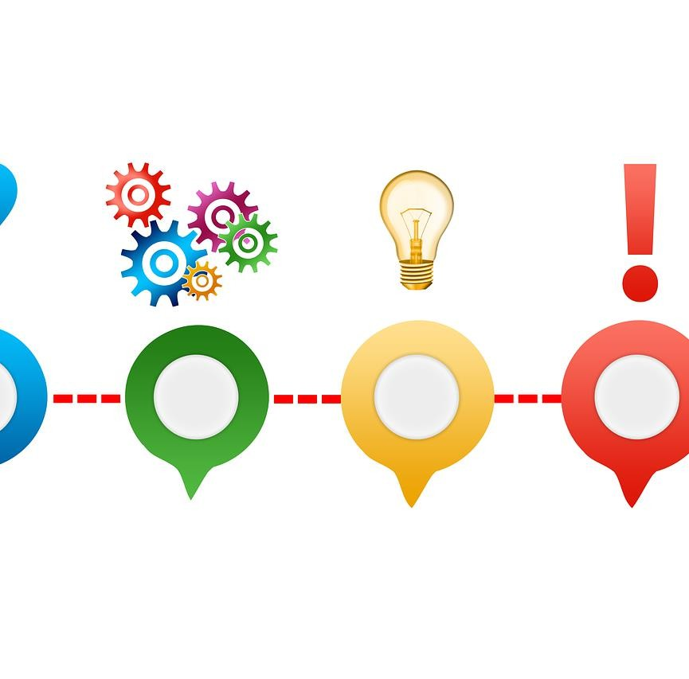
Life to the Full is intended to be partnership between home, school and church.
We know that you already do a fantastic job and we see our programme, Life to the Full, as a means to further develop, support and enrich the partnership between home, school and church so that your child is fully supported.
However if you have any queries or you would like to discuss this further, please contact Mrs Vander Vloet.
Questions?

Slide 25
Closing Prayer
Heavenly Father,
As we come to the end of our time together we thank you for what has been accomplished here.
May the matters discussed serve as a catalyst to move us forward and cause us to advance and see growth in all areas of our lives.
May we leave here recognising that you are the God of all wisdom and you are willing to lead us forward.
This we pray in the name of Jesus the Lord, Amen

